Slide 1

Word Map
Word
transition
Prefix
Root
Suffix
M Step
A Step
P Step
S Step
trans
sit
tion
Meaning
Meaning
Meaning
Across/over
to be located
The act of
Prediction
The act of locating across something
Definition
The act of passing or moving over from one thing to the next
The Word Mapping Strategy by M.Harris, J.B.Schumaker, and D.Deshler
Notes:
Model Lesson 4

Slide 2
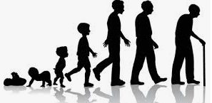
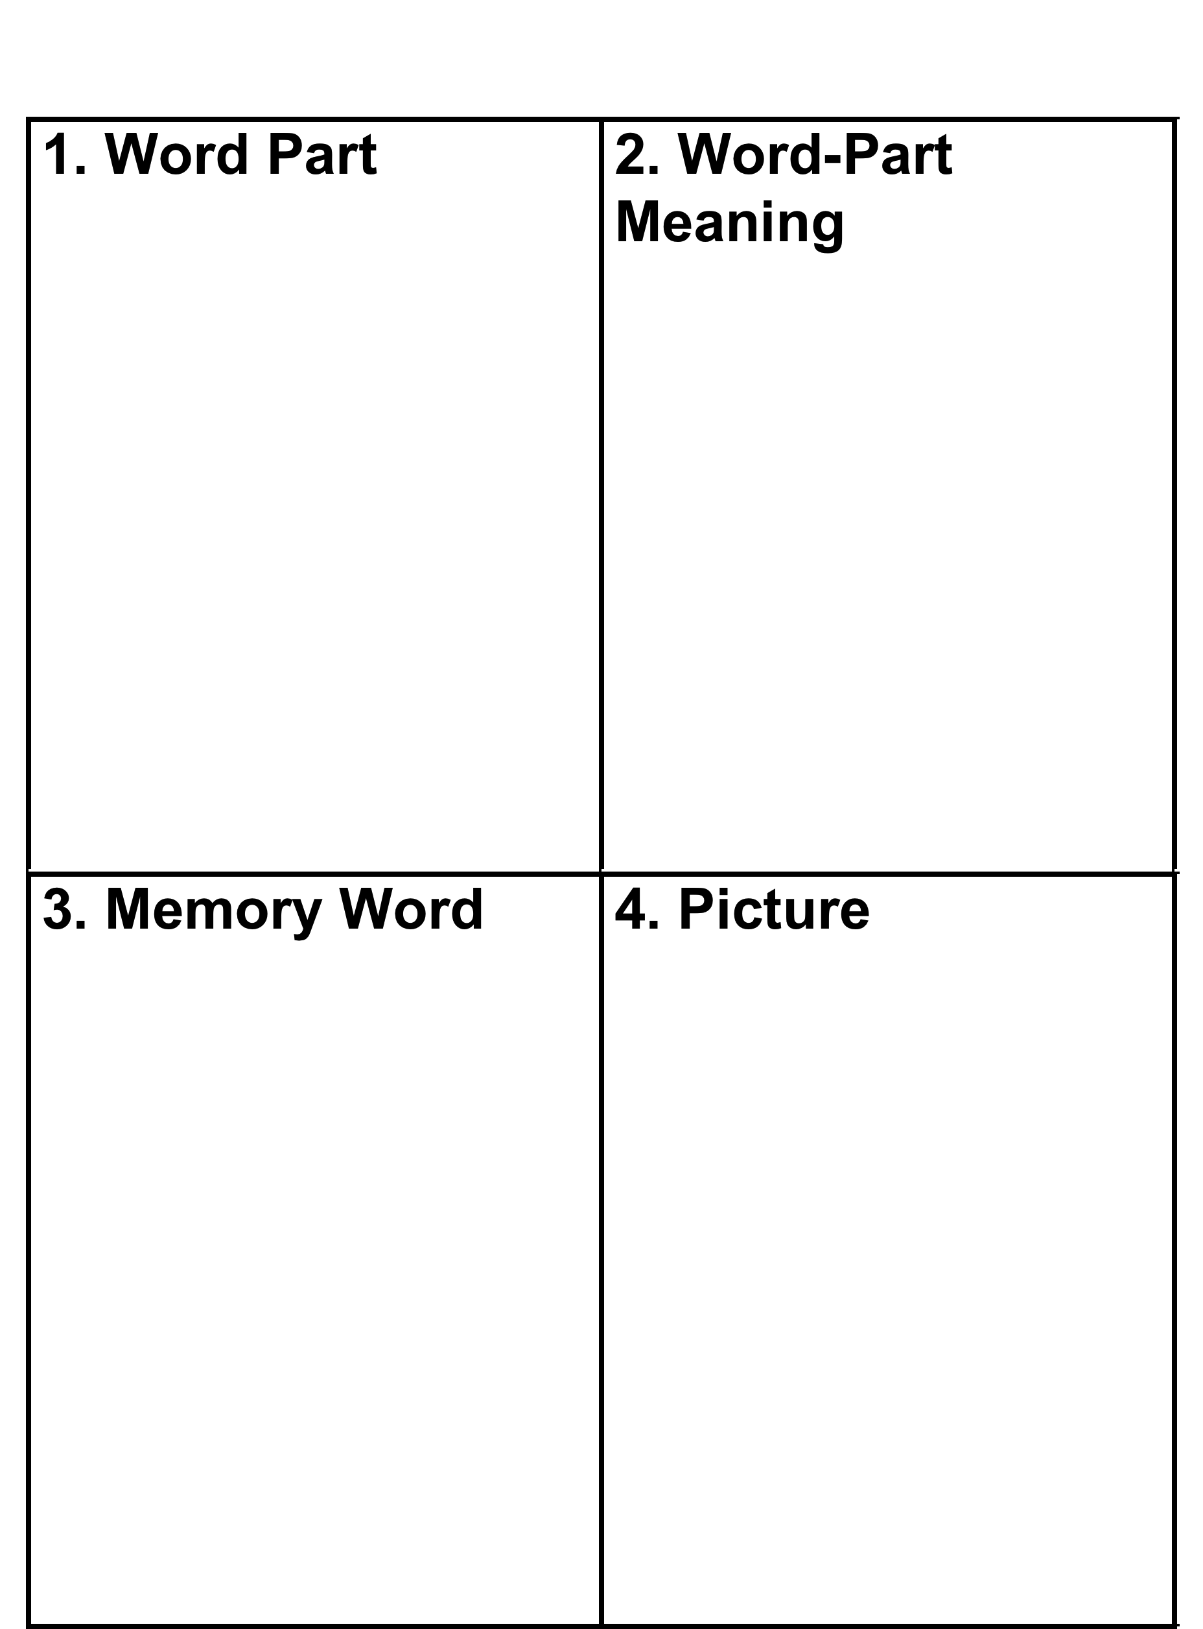
Memory Table
tion
The act of
Cancellation
Transition
representation
The Word Mapping Strategy by M.Harris, J.B.Schumaker, and D.Deshler
Notes:
In the manual they should be following along- making note as you highlight and reference the man example.
Offer to have them select a discipline specific morpheme- will use this through out Practice – with Part 3- “Practicing the Strategy”
math- quad- quadrant, quadrilateral. Quantify, etc; equ- equal, equivalent, equilateral etc
English- they can pick – mem- memory, memorable, remembrance, etc

