Slide 1

The Word Mapping Strategy by Monica Harris Jean Schumaker Don Deshler
Presented by: Kathy Hogsten
Susan Trumbo
Notes:
Both

Slide 2
Vocabulary Instruction Looks Like
Provide students with the meaning of the word and in context (Word Mapping Strategy)
Engage students in use of the word – reading, writing, and discussion(Word Mapping Strategy)
Allow time for word learning (Word Mapping Strategy)
Multiple exposures through review and practice(Word Mapping Strategy)
Create a dialogue to maintain interest in words (Word Mapping Strategy)
Notes:
D

Slide 3
Learning Outcomes: You will be able to:
identify the why for selecting morphemic analysis instruction and how it contributes to literacy, specifically reading comprehension.
identify the Word Mapping Strategy as an explicit and systematic approach to impact student growth in vocabulary.
draft a Word Map and/or Memory Table to implement upon return to the classroom.
Notes:
D

Slide 4
SIM
Student Success
Learning Strategies Curriculum
Content Enhancement Routines
Supports
Social Skills
Self-Advocacy
Strategic Tutoring
Cooperative Thinking Strategies
Community Building Strategies
Motivation Strategies
Teaming Techniques
Notes:
D

Slide 5
What is a Strategy?
An individual’s approach to a task is called a
strategy
It includes how a person thinks and acts when planning, executing, and evaluating performance on a task and its outcomes.
Notes:
D
Although there are numerous definitions of “strategy,” we have chosen this one.
First, a strategy is a person’s approach to a task. Approach is a key word because we are interested in everything related to meeting the demands of the task from initial recognition to completion and evaluation.
Second, it focuses on how a student thinks and on how a student acts. That is, we are concerned with what goes on in the mind and what the person does. Therefore, we are talking about two major types of behavior: cognitive behavior (what goes on in the mind) and overt behavior (what one does).
Third, a strategy focuses on a continuum of performance that includes components related to what happens before, during, and after the task.
Fourth, a strategy includes not only an examination of performance, but also what happens as a result of performance. This last aspect relates to our ability to see the relationship between effort and the resulting performance or outcome.

Slide 6

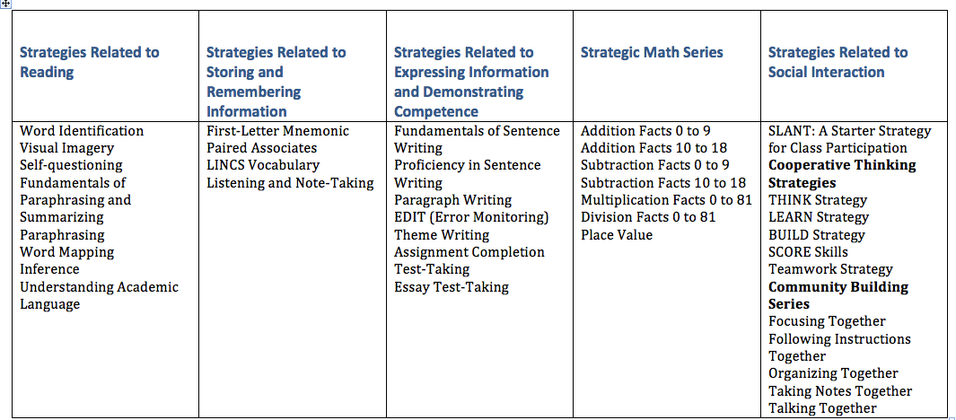
LEARNING STRATEGIES CURRICULUM
Notes:
D
5 strands as seen here

Slide 7
Morphological awareness is…
a metalinguistic ability that focuses on the awareness of the underlying structure of words at the level of meaning.
the ability to recognize, reflect on, and manipulate the sub-lexical structure of words—the roots, prefixes, and suffixes that make up the word.
2013 Wolters Kluwer Health | Lippincott Williams & Wilkins
Notes:
D
- Once students recognize frequently encountered prefixes/suffixes/roots, they can more accurately predict the meanings of unfamiliar words.

Slide 8
An Overview of How the Word Mapping Strategy is Taught
Part I: Determining Students’ Skills with a Pretest
Part II: Introducing Morphemes and the Strategy
Lesson 1: Prefixes
Lesson 2: Suffixes
Lesson 3: Roots
Lesson 4: The Word Mapping Strategy
Part III: Practicing the Strategy
Lessons 1-6: Learning Prefixes
Lessons 7-12: Learning Roots
Lessons 13-18: Learning Suffixes
Part IV: Determining Students’ Progress with a Posttest
Part V: Ensuring Use of the Strategy
Notes:
S
Fig. 2 on pg 4 in manual
WM is lesson-based, but incorporates 8 stages
Pretest
Describe
Model
Verbal practice
Controlled practice
Advanced practice
Posttest
Generalization
Today we will go through Parts I and II
You later go through Parts III-V with a coach (me here in OC)

Slide 9
What’s your timeline for implementation?
Day 1: Part I - Pretest
Day 2-4: Part II - Lesson 1 – Introduction & Prefixes
Day 5-6: Part II - Lesson 2 –Suffixes
Days 8-9: Part II - Lesson 3 –Word Roots
Day 10-13: Part II - Lesson 4 –The Word Mapping Strategy
9-18 Weeks: Part III – Practicing the Strategy
18 lessons (6 ea.) at 1-2 lessons/week
1-2 days: Part IV – Posttest
5 days: Part V – Ensuring Students Use the Strategy
Notes:
S
Dosage is part of fidelity…Consistent implemenation thoughout
Again, today we will focus on Parts I and II – about the first 13 days

Slide 10
Partner Activity
Instructional Sequence-p. 5-7
G1-Pretest-p.5
G2-Describing the Strategy-p.5
G3-Modeling the Strategy-p.5
G4-Practice with Feedback/Factors for “Good” Feedback-p.6 &7
G5-Posttest-p.6
G6-Generalization-p.6
Notes:
S
6 pieces of chart paper with each topic posted
Groups have 10 min. to read and post
Then share out

Slide 11
Instructional Issues: p. 6-8
The instructor manual seems to provide everything for teaching the student. What does the teacher provide?
What factors make for “good” feedback?
How important is “mastery” performance?
What do I do if a students “bogs down” when learning a strategy?
Should I keep all students together?
What modifications can be made in the instruction?
Notes:
S – have them read pgs. 6-8
Discuss each with audience
1 – how you follow outlined procedures and give appropriate feedback/ensure mastery
2 – positive, corrective – categories of errors, individual, timely
3 – correctness and fluency
4 – need for any prerequisites? Reiterate rationales for use
5 – together for initial instruction, but do NOT keep in lock-step for independent practice; advanced may be peer tutors
6 – content classes give 4 intro lessons, then move to ensuring student use

Slide 12
Get Organized – pg. 9
Set up student folders using checklist
Copy needed materials from Appendix C – pg. 118
Notes:
S
Refer to Student Folder Checklist
NOTE to them that they are only going through lesson 4 at this point

Slide 13
Part I: Pretest
Read and highlight in Manual pages 11-13;
ACTIVITY: Scoring the pretest and providing feedback
Notes:
S – guidelines on pg. 89, key on pg. 187
SCORE SAMPLE PRETEST USING GUIDELINES IN GROUPS, THEN CHECK

Slide 14
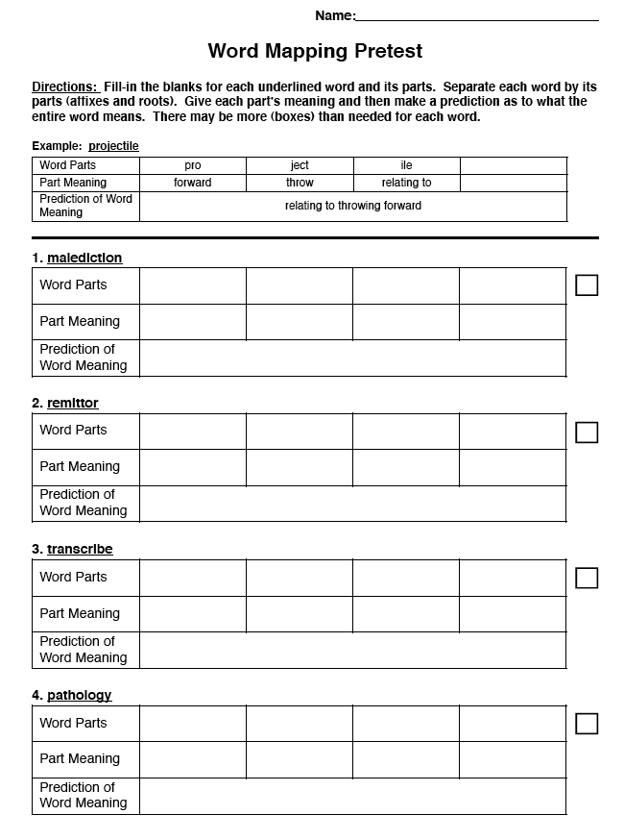
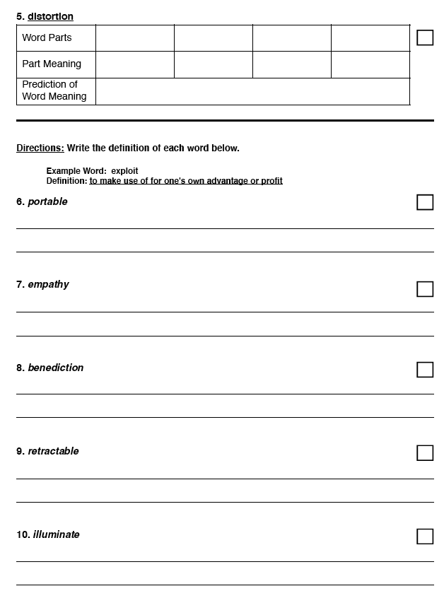
Pretest
(p.118-119)
Notes:
S – again guideline on pg. 89, key on pg. 187
Score in pairs and check
SAMPLE AND SCORE
Pgs. 118-119 in manual

Slide 15
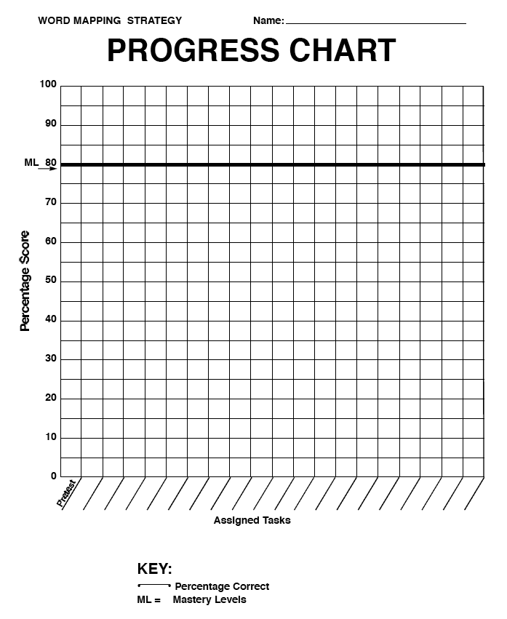
Progress Chart
Notes:
S – sample on pg. 92
Students will chart their own progress as they move through the strategy

Slide 16

The function of feedback is to close the gap between a student’s current level of achievement and the desired level or goal.
.73 ES
Where am I going?
How am I going?
Where to next?
Notes:
S
Feedback for pretest is big picture – score is 67, so there is a gap; where am I going – to 80% - mastery (see progress chart for a visual of gap); I need to learn more word parts and meanings to predict word meaning So in order to close this gap, we need to learn the WM strategy.
Page 12 – nos. 8, 9
How would feedback sound for Student 4 vs. Student 1?
Where am I going? TASK – what is next task
How am I going? PROCESS – what will I be doing to perform task
Where to next? Self-regulation – goals for improving performance

Slide 17
Hattie’s Feedback Levels & Questions
Levels | Major Questions | Three Feedback Questions
1 Task | How well has the task been performed; is it correct or incorrect? | Where am I going? What are my goals?
2 Process | What are the strategies needed to perform the task; are there alternative strategies that can be used? | How am I going? What progress is being made towards the goal?
3 Self-regulation | What is the conditional knowledge and understanding needed to know what you are doing? Self-monitoring, directing the processes and tasks | Where to next? What activities need to be undertaken next to make better progress?
4 Self | Personal evaluation and affect about the learning
Hattie, J.(2011). Visible learning for teachers: Maximizing impact on new learning. New York, NY: Routledge.
Notes:
S
Feedback for pretest is big picture – score is 67, so there is a gap; where am I going – to 80% - mastery (see progress chart for a visual of gap); I need to learn more word parts and meanings to predict word meaning So in order to close this gap, we need to learn the WM strategy.
Feedback needs to be:
Timely
Specific per category of error
Goal-oriented as to strategy for improvement (refer to pg. 7 in manual)
Correspond to phases of learning: novice, proficient, competent
Self =
What would feedback sound like for Student 4 or 1 – select one?

Slide 18

PMT PRACTICE: PRETEST

Slide 19
What’s your timeline for implementation?
Day 1: Part I - Pretest
Day 2-4: Part II - Lesson 1 – Introduction & Prefixes
Day 5-6: Part II - Lesson 2 –Suffixes
Days 8-9: Part II - Lesson 3 –Word Roots
Day 10-13: Part II - Lesson 4 –The Word Mapping Strategy
9-18 Weeks: Part III – Practicing the Strategy
18 lessons (6 ea.) at 1-2 lessons/week
1-2 days: Part IV – Posttest
5 days: Part V – Ensuring Students Use the Strategy
Notes:
S – turn over to D –Part II, Lesson 1
Dosage is part of fidelity…Consistent implemenation thoughout the 8 stages
Completed within one semester
Consider student needs thoughout implementation-Use the timeline to facilitate the discussion around “Analyzing for Learning Difficulties”

Slide 20
Part II: Introducing Morphemes and the Strategy with Four Introductory Lessons
Lesson 1: Intro and Prefixes
• Lesson 2: Suffixes
Lesson 3: Word Roots
Lesson 4: The Word Mapping Strategy
Notes:
D

Slide 21
Manual
Read and highlight the assigned pages
Lesson 1: Intro and Prefixes (pgs. 14-20)
Lesson 2: Suffixes (pgs. 21-27)
Lesson 3: Word Roots (pgs. 28-32)
Notes:
D – Use Notes Sheet and fill out as they read
Participant participation - work with a partner to read through the lesson and highlight key info; write key info on chart paper to share out. Use Notes sheet 1 in manual p.121 to check your group with verbally.
This will give participants an understanding of the contents of the first lesson.
When sharing out tell them the notes sheet, def list and worksheets- are set up for each Lesson1,2,and 3
Mastery levels for each to be noted
Work sheet practice items- complete by group and share 1-2 with group as a practice set; refer to manuals for practice items- Display on white board in the room or on chart paper

Slide 22

Lesson 1: Intro and Prefixes
• Introduce “word parts”
• Define “morphemes”
• Contrast “morphemes with syllables”
• Introduce 3 types of morphemes
• Define “prefix”
Discuss “tricksters”
• Provide examples of “prefixes”
• Explain compound prefixes
Notes:
D
SHOW this when the group shares out as a check for key pieces.
Coming back together and talk about the note sheet and talk about mastery requirements.

Slide 23
Conducting Practice
Group practice isolating prefixes
Independent practice
Group oral reading practice
Paired oral reading practice
Individual oral reading checks
Notes:
Every student has had independent practice, group practice, paired to get to the check
Learning Community – per your classroom

Slide 24
Mastery
• Reading 90% of the prefixes aloud correctly
• A score of 80% or above on a worksheet – pg. 124
Notes:
D
Use strips – key on 189

Slide 25
Progress Chart
Notes:
D
Students will chart their own progress as they move through the strategy

Slide 26
PMT PRACTICE: Part II: Prefixes (Data 1 & 2)

Slide 27
What’s your timeline for implementation?
Day 1: Part I - Pretest
Day 2-4: Part II - Lesson 1 – Introduction & Prefixes
Day 5-6: Part II - Lesson 2 –Suffixes
Days 8-9: Part II - Lesson 3 –Word Roots
Day 10-13: Part II - Lesson 4 –The Word Mapping Strategy
9-18 Weeks: Part III – Practicing the Strategy
18 lessons (6 ea.) at 1-2 lessons/week
1-2 days: Part IV – Posttest
5 days: Part V – Ensuring Students Use the Strategy
Notes:
S
Now into days 5-6 for Lesson 2

Slide 28
Manual
Read and highlight the assigned pages
Lesson 1: Intro and Prefixes (pgs. 14-20)
Lesson 2: Suffixes (pgs. 21-27)
Lesson 3: Word Roots (pgs. 28-32)
Notes:
S
Participant participation - work with a partner to read through the lesson and highlight key info;
Use Notes sheet 2 in manual p.128
Cue Cards 7-13 – pg. 100-107

Slide 29
Part II, Lesson 2: Suffixes
• Define “suffix”
• Provide example suffixes
• Define “inflectional suffixes”
• Define “derivational suffixes”
• Explain the Suffix Guidelines
• Define compound suffixes
Notes:
S
Pg. 21 in manual
SHOW this when the group shares out as a check for key pieces
Same procedure as with Lesson 1

Slide 30
Conducting Practice
Group practice isolating suffixes
Independent practice
Group oral reading practice
Paired oral reading practice
Individual oral reading checks
Notes:
Every student has had independent practice, group practice, paired to get to the check
Learning Community – per your classroom

Slide 31
Mastery
• Reading 90% of the suffixes aloud correctly
• A score of 80% or above on a worksheet – pg. 132
Notes:
S – use strips – answer key – pg. 190
Feedback- what would this look like?

Slide 32
Progress Chart
Notes:
S
Students will chart their own progress as they move through the strategy

Slide 33
PMT PRACTICE: Part II: Suffixes (Data 1 & 2)

Slide 34
What’s your timeline for implementation?
Day 1: Part I - Pretest
Day 2-4: Part II - Lesson 1 – Introduction & Prefixes
Day 5-6: Part II - Lesson 2 –Suffixes
Days 8-9: Part II - Lesson 3 –Word Roots
Day 10-13: Part II - Lesson 4 –The Word Mapping Strategy
9-18 Weeks: Part III – Practicing the Strategy
18 lessons (6 ea.) at 1-2 lessons/week
1-2 days: Part IV – Posttest
5 days: Part V – Ensuring Students Use the Strategy
Notes:
S
Now into days 8-9 – Lesson 3 - Roots

Slide 35
Manual
Read and highlight the assigned pages
Lesson 1: Intro and Prefixes (pgs. 14-20)
Lesson 2: Suffixes (pgs. 21-27)
Lesson 3: Word Roots (pgs. 28-32)
Notes:
S
Participant participation - work with a partner to read through the lesson and highlight key info
Use Notes sheet 3 in manual p.136
Cue Cards – 14-16 – pg. 108-110

Slide 36
Part II, Lesson 3: Roots
• Define and discuss “root”
• Explain Rules for Morphemes
• Practice identifying prefixes, suffixes and roots
Notes:
S
Pg. 28 in manual
SHOW this when the group shares out as a check for key pieces.
Same as with 1 and 2.

Slide 37
Conducting Practice
Group practice identifying morphemes
Independent practice
Individual oral reading checks – pg. 31, #11
Notes:
S
Every student has had independent practice, group practice, paired to get to the check
Learning Community – per your classroom

Slide 38
Mastery
A score of 80% or above on one worksheet
Notes:
S
Strips and key on pg. 191

Slide 39
Progress Chart
Notes:
S
Students will chart their own progress as they move through the strategy

Slide 40
PMT PRACTICE: Part II: Word Roots (Data 1 & 2)

Slide 41
What’s your timeline for implementation?
Day 1: Part I - Pretest
Day 2-4: Part II - Lesson 1 – Introduction & Prefixes
Day 5-6: Part II - Lesson 2 –Suffixes
Days 8-9: Part II - Lesson 3 –Word Roots
Day 10-13: Part II - Lesson 4 –The Word Mapping Strategy
9-18 Weeks: Part III – Practicing the Strategy
18 lessons (6 ea.) at 1-2 lessons/week
1-2 days: Part IV – Posttest
5 days: Part V – Ensuring Students Use the Strategy
Notes:
S
Now into Days 10-13 – WM Strategy

Slide 42
Part II: Introducing Morphemes and the Strategy with Four Introductory Lessons
• Lesson 1: Intro and Prefixes
• Lesson 2: Suffixes
• Lesson 3: Word Roots
• Lesson 4: The Word Mapping Strategy
Notes:
S
Same as with previous lessons.

Slide 43
Part II, Lesson 4: The Word Mapping Strategy
Advance Organizer
Describe and model the Word Mapping Strategy steps
• Introduce the mnemonic device “MAPS”
Practice Word Mapping (maps) given words
• Describe and model how to complete a Memory Table & SELF-TEST
• Practice completing memory tables with given words & SELF-TESTING
Post Organizer
Notes:
S
Pages 33-39 Everyone reads and highlights- independently and then bring back together ; read page 5 earlier may want to refresh - Describing the strategy and modeling the strategy

Slide 44
Word Map
Word
Prefix
Root
Suffix
M Step
A Step
P Step
S Step
Meaning
Meaning
Meaning
Prediction
Definition
Notes:
S
Model Lesson 4

Slide 45
Word Mapping Strategy
Map the word parts
Attack the meaning of each part
Predict the word’s meaning
See if you’re right!
Notes:
S

Slide 46
Word Map
Word
prediction
Prefix
Root
Suffix
M Step
A Step
P Step
S Step
pre
dict
ion
Meaning
Meaning
Meaning
Map the targeted
word by breaking it
down into its word parts
before
Prediction
Definition
Notes:
S
See “Targeted Words” list in packet and back of sheet. Use this for practice at this point with students.
Explain, good to use words that may not be an easy fit, like “sovereignity”

Slide 47
Word Map
Word
prediction
Prefix
Root
Suffix
M Step
A Step
P Step
S Step
pre
dict
ion
Meaning
Meaning
Meaning
act, result, or state of
before
say or speak
Prediction
Attack the meaning
by translating each
word part into
its meaning.
Definition
Notes:
S
USE THE PREFIX/SUFFIX/ROOTS LISTS

Slide 48
Word Map
Word
prediction
Predict the meaning
of the word by
putting the word part
meanings together
Prefix
Root
Suffix
M Step
A Step
P Step
S Step
pre
dict
ion
Meaning
Meaning
Meaning
act, result, or state of
before
say or speak
Prediction
the act of speaking before
Definition
Notes:
S
Often have to experiment with order as predict definition.

Slide 49
Word Map
prediction
Word
See if your prediction
is correct by checking
with the dictionary
or someone
Prefix
Root
Suffix
M Step
A Step
P Step
S Step
pre
dict
ion
Meaning
Meaning
Meaning
act, result, or state of
before
say or speak
Prediction
the act of speaking before
Definition
something foretold; a prophecy
®
Notes:
S

Slide 50
Word Map-MODEL
Word
prediction
Prefix
Root
Suffix
M Step
A Step
P Step
S Step
pre
dict
ion
Meaning
Meaning
Meaning
act, result, or state of
before
say or speak
Prediction
the act of speaking before
Definition
something foretold; a prophecy
Notes:
S

Slide 51
Word Mapping Activity
With your partner, map the following words:
• circumspection
• telepathy
• transmitter
Notes:
S – DRAW WMAP prior to start of session
have them go to the whiteboard or chart paper – words on tops and they go up and MAP with a partner
MODEL MAPPING “BIENNIAL” FIRST
Participants do other 3(word map sheets)
Refer to prefix/suffix/root lists in manual / handouts

Slide 52

Memory Table
-tion
act, result, state of
evaporation
Notes:
Multiple words in this unit (pecipitation, evaporation, condensation…) all have the suffix –tion. You may decide to have students make a memory table to learn the meaning of that specific suffix to help them better understand the meaning of each of these vocabulary words.

Slide 53
Self-Test- p.38
1- Say the word part.
What is the memory word?
2- Say the Memory Word.
What is the picture for the memory word?
3-Say something about the picture.
What is the meaning of my word part?
4- Say the meaning of the word part.
Check to see if you are correct.
Notes:
D

Slide 54
Mastery
Completion of Word Maps and Memory Tables as assigned.
Notes:
D – select from classroom needs for word parts to use on Memory Tables - pg. 38 - #9, #12 – another oral reading check – another opportunity for mastery
Caution is to check and ensure they have completed the previous practice opportunities.
What if we have 2 students who have not passed the oral reading check?
Do we move them into Part III; find out why not able to meet mastery?

Slide 55
Progress Monitoring Tool for Word Mapping
Aligns with your instruction
Ongoing progress and trends
Shape student feedback
Open the Word Mapping PMT File sent ahead of time
* See PM Tool Instructions Handout
Notes:
Sent ahead of time…should have received from admin.

Slide 56
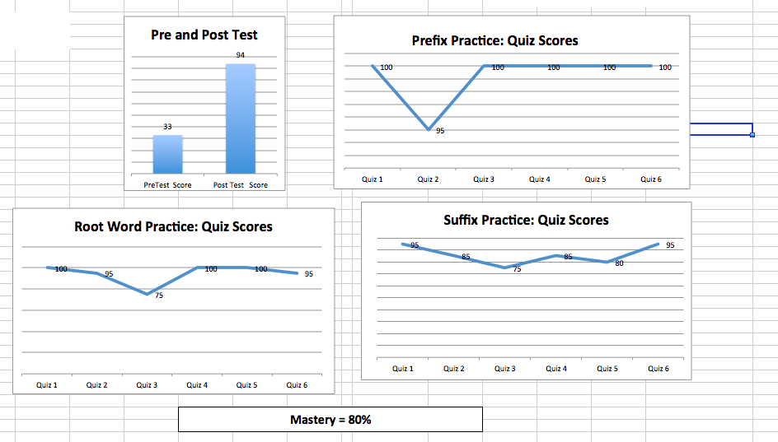
Student Graph: End Result
Student
Motivation
Trends & Feedback

Slide 57
Parts of Instruction
Part I: Pretest
Part II: Introducing Morphemes and the Strategy
Part III: Practicing the Strategy
Part IV: Posttest
Part V: Ensuring Students Use the Strategy
Notes:
Pages 40-44 Everyone reads and highlights- independently and then bring back together ,

Slide 58
Generic Practice Lesson Format (p.40-44)
Introduce the Word Parts Table (p.45, 114)
Conduct the Paragraph Activity (p.147)
Conduct the Word-Part Activity (p.114)
Discuss “tricksters”(p.115)
Conduct the Prediction Activity (p.147)
Have the students make Memory Tables (p.146)
Conduct the Word Mapping Activity (p.145)
Administer the quiz (p.165)
Notes:
SHOW this when the group shares out as a check for key pieces

Slide 59
Introduce the Word Parts Table
Start Here
Prefix | Meaning | Examples
un- | not | unhappy, unanswered, unhealthy
in-, im-, il-, ir- | not | indirect, impossible, illegal, irregular
dis- | not, apart, away | disability, dislocate, discard
Notes:
Use the morphemes in the Lesson 4-
Again, discipline specific word parts per earlier slide

Slide 60
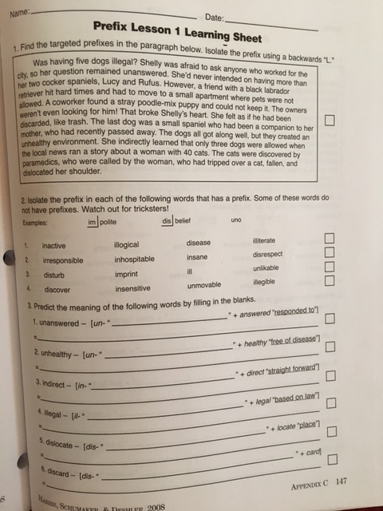
Paragraph
Activity

Slide 61
Word-Part
Activity

Slide 62
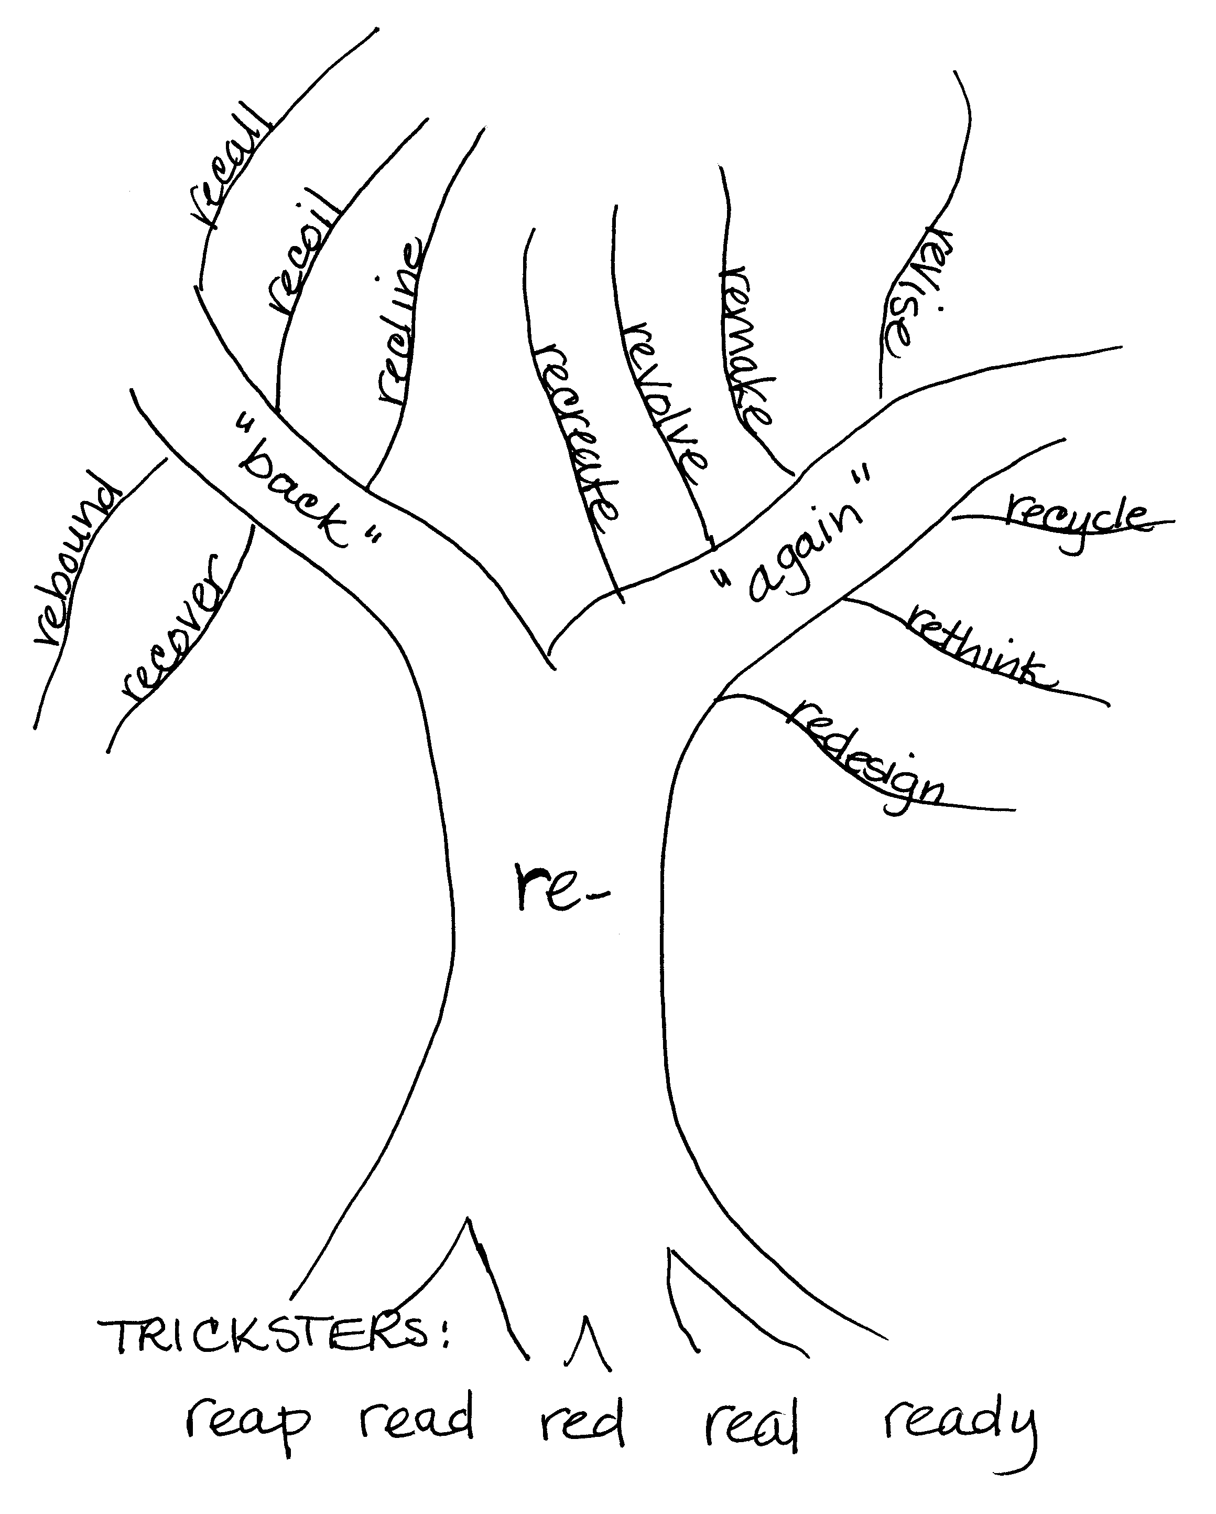
Tree with Tricksters
Think about
tricksters!
Notes:
DISCUSS USES AS A GALLERY WALK WITH STUDENTS (DO WITH PARTICIPANTS IF TIME ALLOWS)

Slide 63
Prediction
Activity

Slide 64
Learning Sheets-80% Mastery

Slide 65
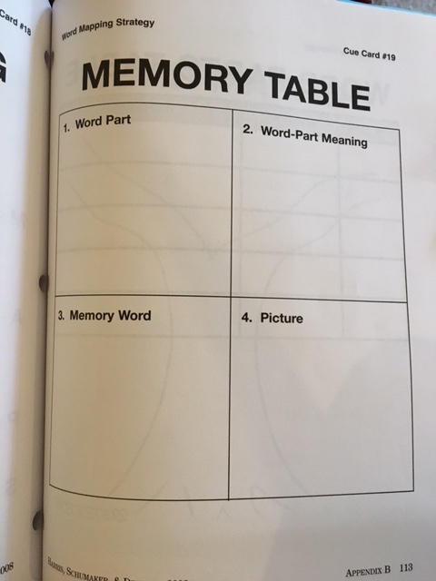
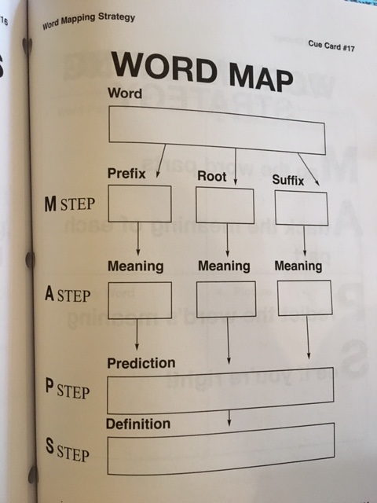
Memory Table & Word Maps Activities-targeted word parts
#6 Memory Table-p.42
#7 Word Mapping-p.43/44

Slide 66
Administer the Quiz-80% Mastery
Require accountability for:
• Learning the meaning of targeted morphemes
• Learning the meaning of targeted words
Notes:
Practice and feedback- read page 6 Practice and Feedback and page 7 What factors make good feedback- refresh from earlier read if necessary

Slide 67
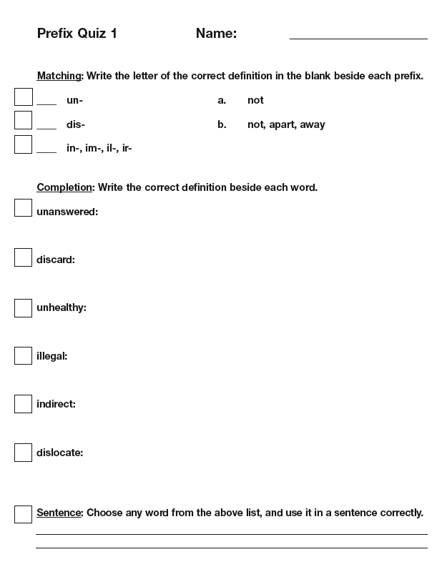
Last Part
Notes:
Pg. 165
Key – pg. 19
Same for suffixes and roots

Slide 68
PMT PRACTICE: Part III: Prefix (Practice Lessons)

Slide 69
Options for Part III
Conduct all the activities on one day
Conduct the activities across the week,
with the quiz on Friday

Slide 70
Part IV - Posttest
Read and highlight in Manual pages 81-83, p.183 & 185
Mastery = 80%

Slide 71
PMT PRACTICE: Part IV: Posttest

Slide 72
Part V – Ensuring Students Use the Strategy/Questions
Read and highlight pgs. 84-88
Generalization
Situations and usage
Assignments using materials from classes
Use Word Mapping Strategy fluently on these assignments=MASTERY

Slide 73
What’s your timeline for implementation?
Day 1: Part I - Pretest
Day 2-4: Part II - Lesson 1 – Introduction & Prefixes
Day 5-6: Part II - Lesson 2 –Suffixes
Days 8-9: Part II - Lesson 3 –Word Roots
Day 10-13: Part II - Lesson 4 –The Word Mapping Strategy
9-18 Weeks: Part III – Practicing the Strategy
18 lessons (6 ea.) at 1-2 lessons/week
1-2 days: Part IV – Posttest
5 days: Part V – Ensuring Students Use the Strategy
Notes:
Dosage is part of fidelity…Consistent implemenation thoughout the 8 stages
Completed within one semester
Consider student needs thoughout implementation-Use the timeline to facilitate the discussion around “Analyzing for Learning Difficulties”

Slide 74
How might we use the Progress Monitoring Tools?
Facilitate Coaching-Planning/Troubleshooting
Eligibility/IEP implications
More?

