Slide 1

The Word Identification Strategy by
Keith Lenz
Jean Schumaker
Don Deshler
Victoria Beals
Presented by: Susan Trumbo
Kathy Hogsten
Stephanie Samples
Deborah Seward

Slide 2
Advance Organizer
Explore the purpose and match of the Word Identification Strategy with current student needs and demands through pretests
Become familiar with the eight stages of instruction
Practice scoring student samples
Practice the initial stages of the Word Identification Strategy with fidelity
Notes:
Participant and presenter introductions

Slide 3


®
is an integrated model of evidence-based practices to address many of the needs of diverse learners, primarily focused on adolescents. It has been under research and development for more than 35 years at the University of Kansas Center for Research on Learning.
Notes:
Emphasize: Evidence-based practices that have been under research and development for more than 35 years.

Slide 4

Content
Enhancement
Routines
Learning
Strategies
Curriculum
Evidence-based Instruction
Notes:
4
LS in the morning and CERs in the afternoon

Slide 5

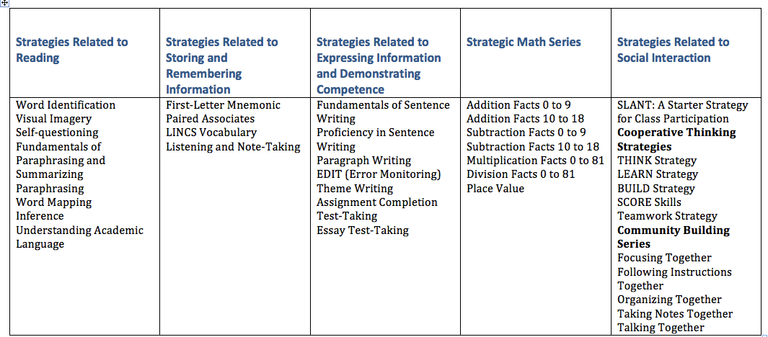
LEARNING STRATEGIES CURRICULUM
Notes:
Reference to the handout
Later today we will be looking at IEPs and reflecting back on the LS available to meets student needs to make a good match-
Highlight the strands

Slide 6
What We Know…
The ability to effectively and efficiently decode words is necessary for reading comprehension (Boardman et al., 2008; Nagy, Berninger, & Abbott, 2006; Scammacca et al., 2007; Wharton-McDonald & Swiger; 2009). Researchers have determined that about one-third of middle school struggling readers have difficulty at the basic word level, and they have difficulty with comprehension (Brasseur-Hock, Hock, Kieffer, Biancarosa, & Deshler 2011; Paulesu et al., 2001; Scammacca et al., 2013; Vaughn et al., 2010).

Slide 7
What are WE Doing?
Teach explicit strategies to decode unknown words
  Teachers who use explicit instruction explain the strategy, model the process, provide guided practice with scaffolding, and move to application at an independent level.

Slide 8
Instructional Issues: p. 6-8
The instructor manual seems to provide everything for teaching the student. What does the teacher provide?
How important is “mastery” performance?
What do I do if a student “bogs down” when learning a strategy?
What modifications can be made in the instruction?
Notes:
Kathy and Deborah and Stephanie

Slide 9
Timeline for Implementation
Day 1: Pretest (3 parts: prefix/suffix test, grade-level passage w/ comprehension questions)
Day 2: Feedback Conferences (show scores, task and process feedback, make commitments)
Days 3-5: Prerequisite Prefix/Suffix Lessons
Days 6-7: Describe (1 or 2 lessons)
Days 8-9: Continue Describe and/or Model
Days 10-11: Verbal Practice with Feedback
Days 12-17: Controlled Practice with Feedback
Days 18-23: Advanced Practice with Feedback
Days 24-26: Posttest with Feedback and Make Commitments
Day 27: Begin Generalization (4 phases)
Notes:
Dosage is part of fidelity…Consistent implemenation thoughout the 8 stages
Completed within a 9-week quarter-Actually a 5-6 week strategy moving into Generalization
Consider student needs thoughout implementation-Use the timeline to facilitate the discussion around “Analyzing for Learning Difficulties”

Slide 10
Progress Monitoring Tool for Word Identification
Aligns with your instruction
Ongoing progress and trends
Shape student feedback
Open the Word Identification PMT File sent ahead of time
* See PM Tool Instructions Handout
Notes:
Sent ahead of time…should have received from admin.

Slide 11
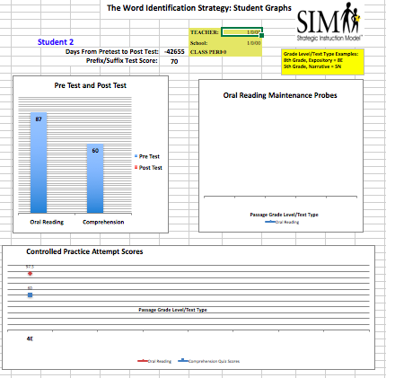
Notes:
Change with updated PMTool info

Slide 12
How might we use the Progress Monitoring Tools?
Facilitate Coaching-Planning/Troubleshooting
Eligibility/IEP implications
More?

Slide 13

Purpose of this Strategy
  To give the student a strategy for decoding multisyllabic words.

Slide 14
At-A-Glance
Step 1: Discover the sounds and context
Step 2: Isolate the beginning
Step 3: Separate the ending
Step 4 :Say the stem
Step 5: Examine the stem
Step 6: Check with someone
Step 7: Try the dictionary
Notes:
Mnemonic – each step begins with a verb – call to action and becomes metacognitive – a strategy used vs. ‘skipping the word’

Slide 15
Word Identification Strategy Results
Performance on Grade-Level Materials
Before Instruction
After Mastery
20 Words
incorrectly
Pronounced
40%
Comprehension
3 Words
incorrectly
Pronounced
70%
Comprehension

Slide 16
Book Walk
Put a POST-IT on each of the following pages:
Page 3 Summary of how to teach the Word Identification Strategy
Page 12 Instructional Methods: Begin the stages
Page 85 Appendix A: Evaluation Guidelines
Page 93 Appendix B: Instructional Materials (cue cards, stem worksheet, verbal practice checklist, assignment sheet, scoring sheet, progress chart, and management chart)
Page 112 Appendix C: Prerequisite Lessons (prefix/suffix lessons, prefix/suffix lists, prefix/suffix worksheets)
Page 132 Appendix D: Answer Keys
Page 136 Appendix E: Suggested Commercially Available Materials
Notes:
16

Slide 17
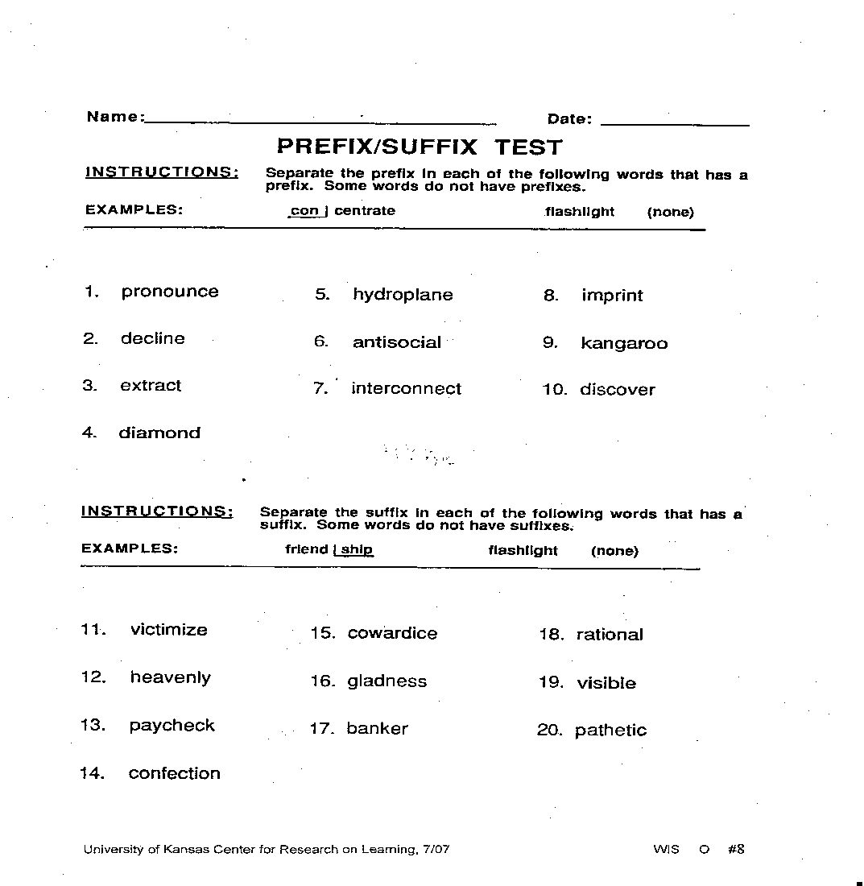
Stage 1: Pretest (Pgs 12-15)
Page 12
35 minutes for all 3 tests & 10 minutes per student to give results
Directions include 3 tests:
  1. Prefix/Suffix Test
  2. Reading passage test
  3. Comprehension questions
  Mastery = 80%
Score & share results
  Score Pretest: Pg 133
Notes:
17
Reference the Student Materials Manuals for selection of pretest passages

Slide 18
Mastery Requirements: Pg 17
Prefix/Suffix Test Score: 80%
Oral Reading Score: Must pronounce 99% correctly
Comprehension Score: Must answer 60% correctly
Notes:
18

Slide 19
Student Materials ‘Fast Facts’
Leveled passages with comprehension quizzes – grades 4-10
TE – 6 passages per grade level
SE – 4 passages per grade level
Half Expository (E)/ Half Narrative (N)
6 paragraphs/16 challenge words to DISSECT
Can be copied for student use

Slide 20
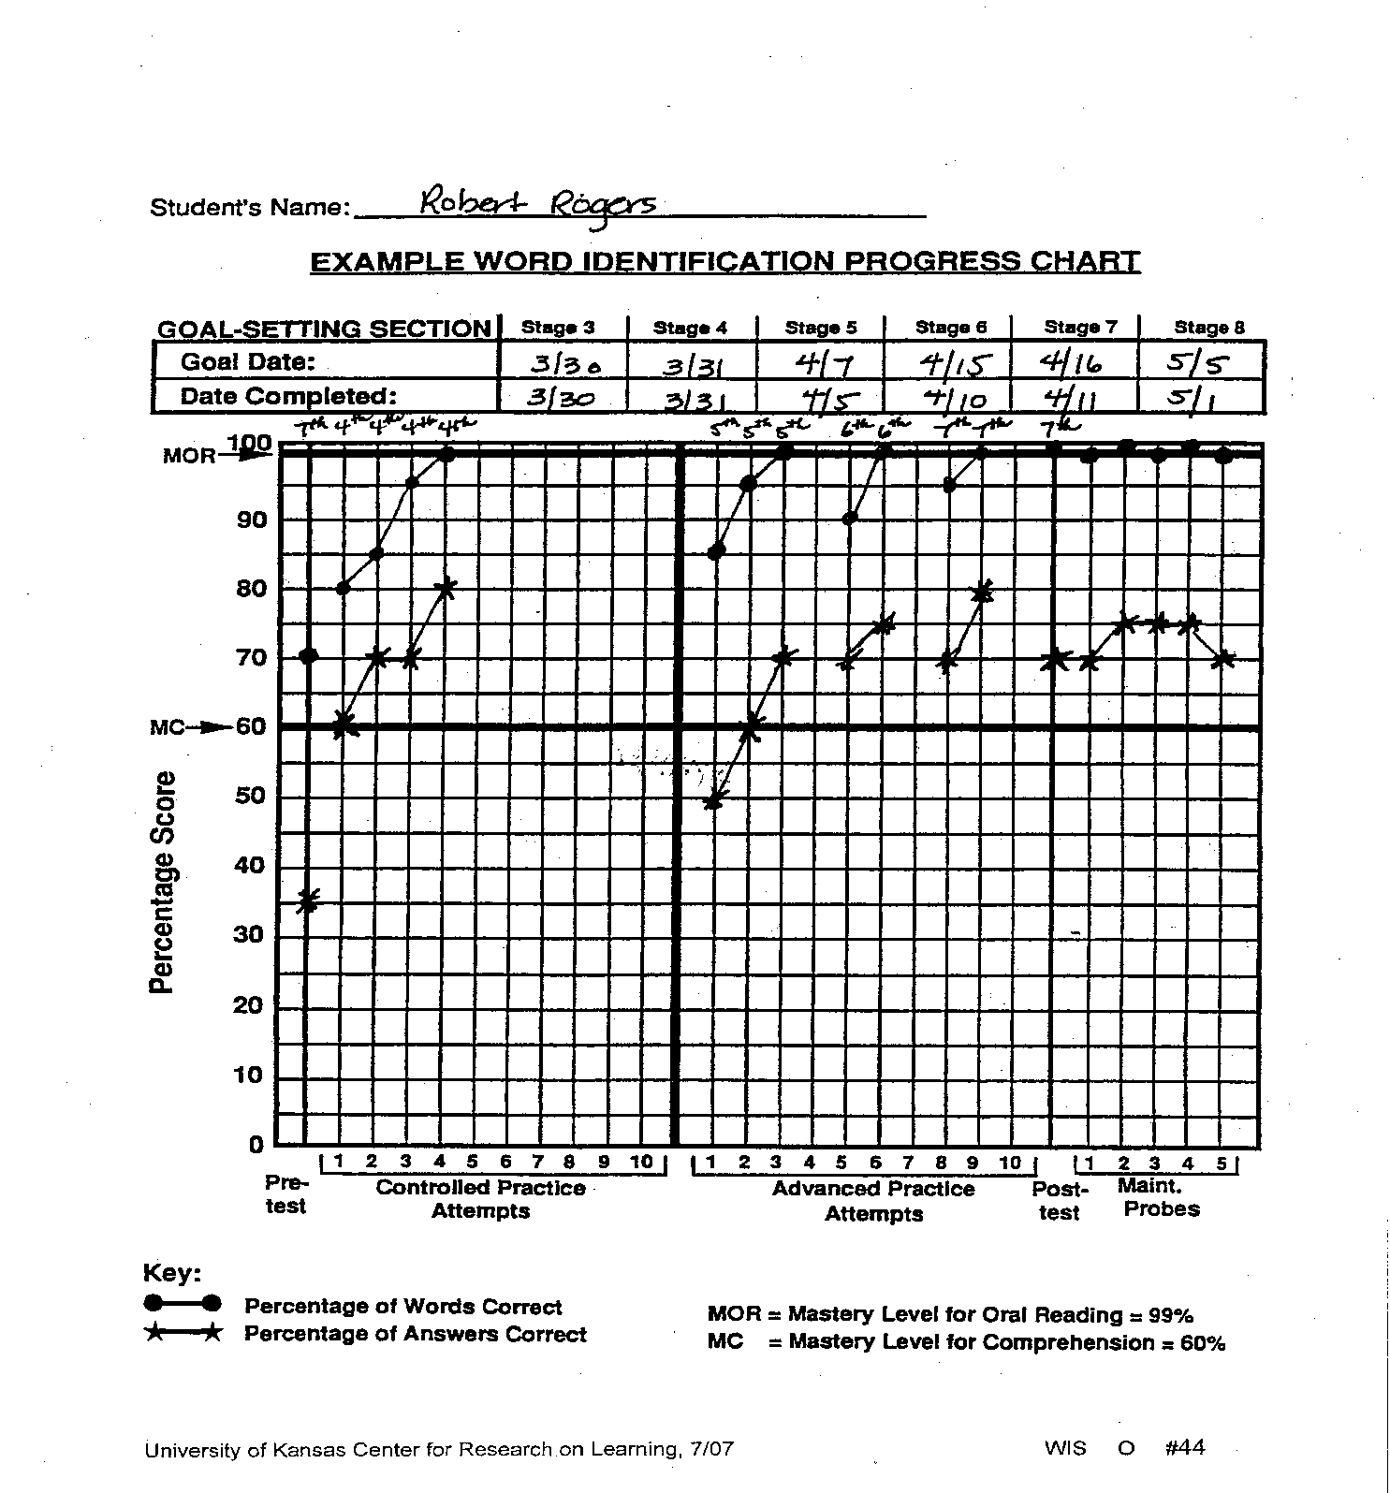
Page 90
Notes:
20
Discuss only the pre test
scoring part of Roger’s Sample Progress Report

Slide 21

PMT PRACTICE: PRETEST
Notes:
Enter scores for a ‘student’

Slide 22
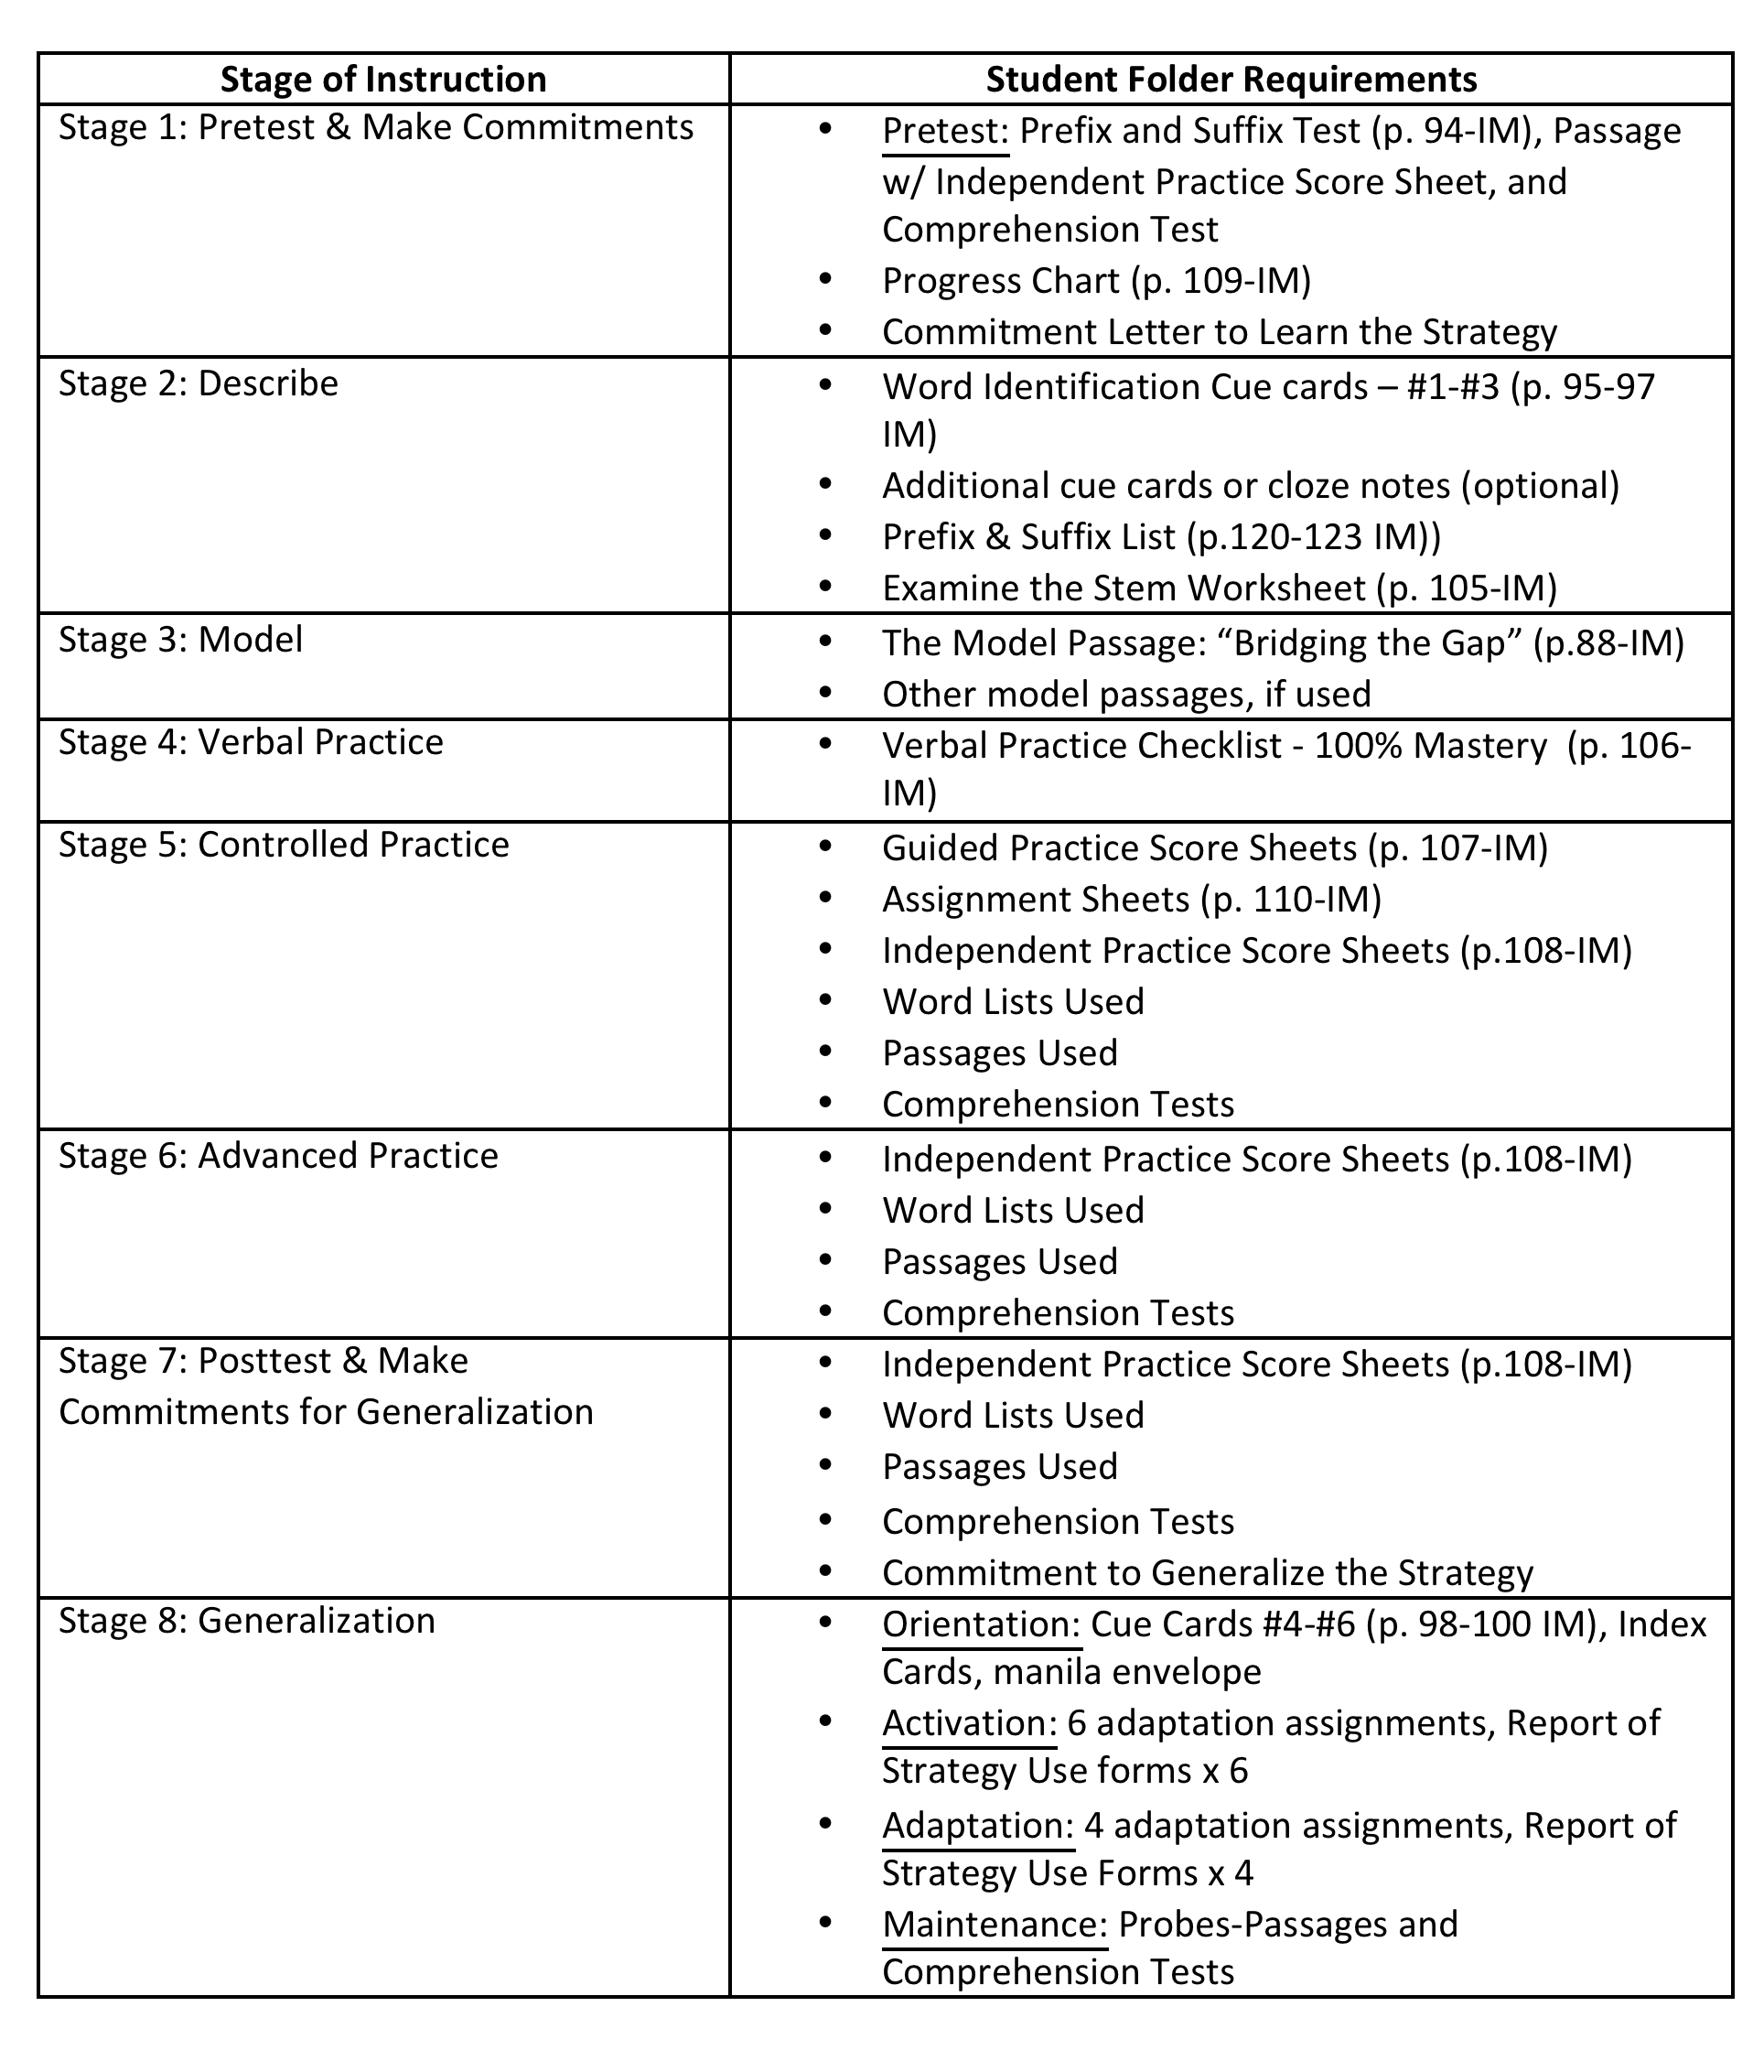
Student Folder: Checklist

Slide 23

FIDELITY CHECKLIST-STAGE 1

Slide 24
Prerequisite Lessons
Read and highlight pgs. 112-117
To be used if students do not score 80% or better on the prefix/suffix part of the pretest
Mastery: 80% - ‘Isolate the Prefix Worksheet’ & 80% - ‘Separate the Suffix Worksheet’
Pronunciation mastery: 90% of the prefixes on ‘Prefix List’ & 90% of the suffixes on ‘Suffix List’

Slide 25
PMT: Prefix/Suffix Worksheets
Notes:
Enter scores for a ‘student’

Slide 26
Stage 2: DESCRIBE
Read, tab, highlight, and take notes pages 19-33.
Give Advance Organizer
Rationales for the strategy
Explain steps of the strategy-cue cards & notes
Discussion of Goal
Post organizer

Slide 27
DISSECT
Discover the Sounds
and Context
Congratulations were in order when Ben won the contest.
Separate
the
Ending(s)
Isolate
the
Beginning
Congratulations
Say the stem
Examine the stem
Notes:
27

Slide 28
DISSECT
If a stem or part of the stem begins with:
A vowel, divide off the first two letters
A consonant, divide off the first three letters.
Rule 1:
Discover the Sounds
and Context
Congratulations were in order when Ben won the contest.
Separate
the
Ending(s)
Isolate
the
Beginning
Congratulations
Say the stem
Examine the stem
Notes:
28

Slide 29
DISSECT
Which rules?
Rule 1 and 2
Discover the Sounds
and Context
The news article created quite a
scandal.
scandal
Separate
the
Ending
Isolate
the
Beginning
s candal
Say the stem
Examine the stem
Notes:
29

Slide 30
DISSECT
Which rules?
Rules 1 and 2
Discover the Sounds
and Context
Bob tried hard not to clench his fist hard when the dog barked at him.
clench
Isolate
the
Beginning
Separate
the
Ending
C lench
Say the stem
Examine the stem
Notes:
30

Slide 31
DISSECT
Which rules?
Rule 1&3
Discover the Sounds
and Context
I believe it is time to go on a diet.
Separate
the
Ending
Isolate
the
Beginning
believe
diet
Say the stem
Examine the stem
Notes:
31

Slide 32

Examine the Stem
(P. 97)
Let’s take a closer look at how we “examine a stem.”
-Use the Rules of 2’s & 3’s
-Total of THREE Rules

Slide 33
PMT: DESCRIBE
Notes:
Enter scores for a ‘student’

Slide 34
FIDELITY CHECKLIST- STAGE 2

Slide 35

Stage 3: MODEL
Read, tab, highlight, and take notes pages 34-40.
Need document camera/interactive board
Select Model Passage- “Bridging the Gap”
Do the Model- DISSECT
Discussion of Goal
Post organizer

Slide 36
Types of Models:
Presentation: Think-a-loud
Student Enlistment: Checks for understanding and shapes responses

Slide 37
Modeling
“Teacher Model” using the model passage: “Bridging the Gap”
Manual P. 88
Using ‘DISSECT’ on the following words:
- cantilever
- suspension
- achievement

Slide 38
DISSECT
Which rules?
Rule 1 and 2
Discover the Sounds
and Context
The news article created quite a
scandal.
scandal
Separate
the
Ending
Isolate
the
Beginning
s candal
Say the stem
Examine the stem
Notes:
38
This rule is not addressed in the video.

Slide 39
PMT: MODEL
Notes:
Enter completion date for model stage

Slide 40
Fidelity Checklist-Stage 3

Slide 41
Stage 4: VERBAL PRACTICE
Read, tab, highlight, and take notes on pages 41-46.
Make it Fun- Rapid Fire Verbal Rehearsal
Checklist- Individual (p.106)
Group Practice to Partner to Individual Practice
Feedback on performance
Notes:
‘Stand up’ activity per video (DG)

Slide 42
Word Identification Strategy
Verbal Practice Checklist
Pg 106
* Also: Written Quiz for large class size
Notes:
42
‘Stand up activity’

Slide 43
PMT: VERBAL PRACTICE
Notes:
Enter scores for a ‘student’

Slide 44
Fidelity Checklist- Stage 4

Slide 45
Stage 5: Controlled Practice & Feedback
*Read, tab, highlight, and take notes on pages 47-55.
Passages with comprehension questions from Student Materials Book
Student’s independent reading level
Practices: guided, small group & independent
20-30 minutes per passage + quiz
Score test & provide feedback
Notes:
45
Plus use of Student Materials book for WID

Slide 46
SCORING
Same as with pretest
See ‘Student Materials’ book - TE
  Answer keys – pg. 87-100
Notes:
If we have any CP from K. Hudson, otherwise use from PD training supplemental handouts

Slide 47
WORD IDENTIFICATION STRATEGY
INDEPENDENT PRACTICE SCORE SHEET
Name:
Robert Rogers
Date:
April 4
Pretest:
Posttest:
Practice:
C #3
Maint. Probe:
Words Missed
Words Missed
Words Missed
cantilever
suspension
achievement
prehistoric
times
tombs
engineers
cantilever
diamond
Words Correctly
suspension
Dissected
Page 89
balanced
tough
Verrazano
gorge
crumpled
suspension
compared
collapse
Calculating the Score:
Total No. Words
Number of
Total Number
in the Passage
Words Missed
Words Correct
390
15
375
(minus)
375
% of Words Correct
Total No. Words Correct
96%
Total No. Words in the
390
Passage
Notes:
47
The Challenge

Slide 48
Word Identification Feedback Checklist
Word Identification Feedback
I like the way you…
__Discovered the sounds and context
__Isolated the beginning
__Separated the ending
__Said the stem
__Examined the stem
__Checked with someone
__Tried the dictionary
Next time, you’ll do even better if you try to…
__Sound out any word you can’t pronounce
__Figure out any word you can’t pronounce by reading the entire sentence (context)
__Isolate the beginning of the word using your word beginning list
__Separate the ending of the word using your word ending list
__Use the Rules of Twos and Threes to help you say the stems
__Be polite when checking with someone
__Make use of an online dictionary or classroom dictionary if no one can help you
See me if you need help!
Notes:
48

Slide 49
PMT: CONTROLLED PRACTICE
Notes:
Enter scores for a ‘student’

Slide 50
Fidelity Checklist- Stage 5

Slide 51
Stage 6: Advanced Practice & Feedback
*Read, tab, highlight, and take notes on pages 60-63.
Goal: To ensure students use the Word ID strategy on materials above their independent reading level
Passages with comprehension questions from Student Materials Book: 1-2 levels above starting point
15-25 minutes per passage + quiz
Use Independent Score Sheet Pg 101
Score test & provide feedback
Notes:
51

Slide 52
Mastery Requirements:
Pg 54
Word ID Score: Must pronounce 99% correctly
Comprehension Score: Must answer 60% correctly
Fluency: must read using strategy w/out long pauses, false starts & disfluencies
Notes:
52

Slide 53
Fidelity Checklist- Stage 6

Slide 54
Stage 7: Posttest and Make Commitments
*Read, tab, highlight, and take notes on pages 60-63.
Passages 2 levels above starting point or at student’s grade level with comprehension questions
25 min. test (though not timed) & 5 min. feedback
Use Independent Score Sheet Pg 101
Score test & provide feedback
Explain Generalization Stage 8 and obtain commitments
Notes:
54

Slide 55
Fidelity Checklist- Stage 7

Slide 56
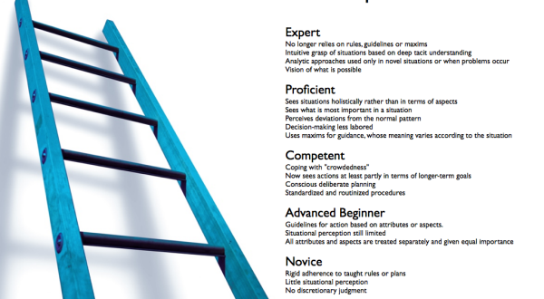
From Acquisition to Generalization
4 PHASES: 2-3 weeks
PHASE 1- ORIENTATION
PHASE 2- ACTIVATION
PHASE 3- ADAPTATION
PHASE 4- MAINTENANCE

