Slide 1
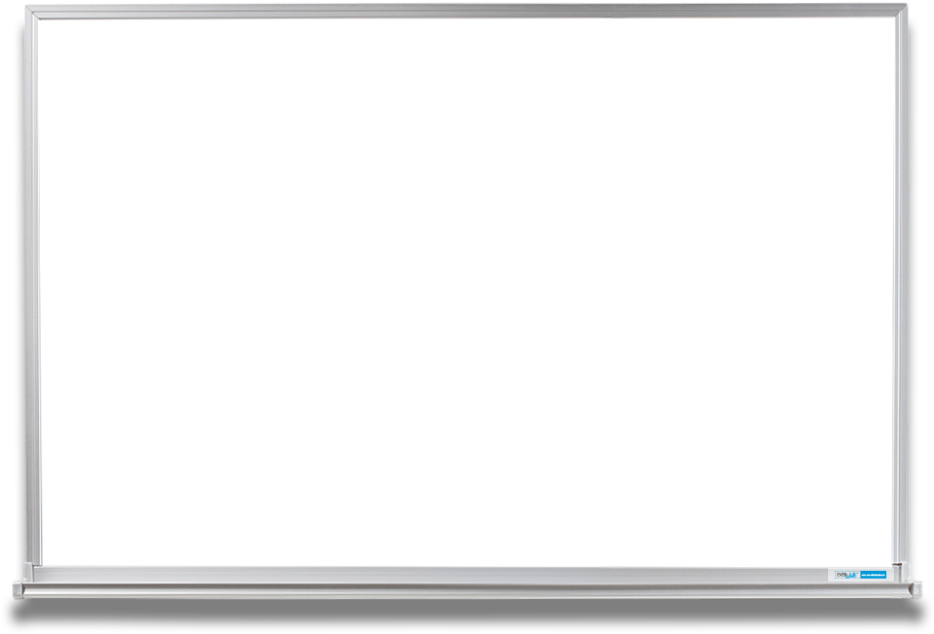

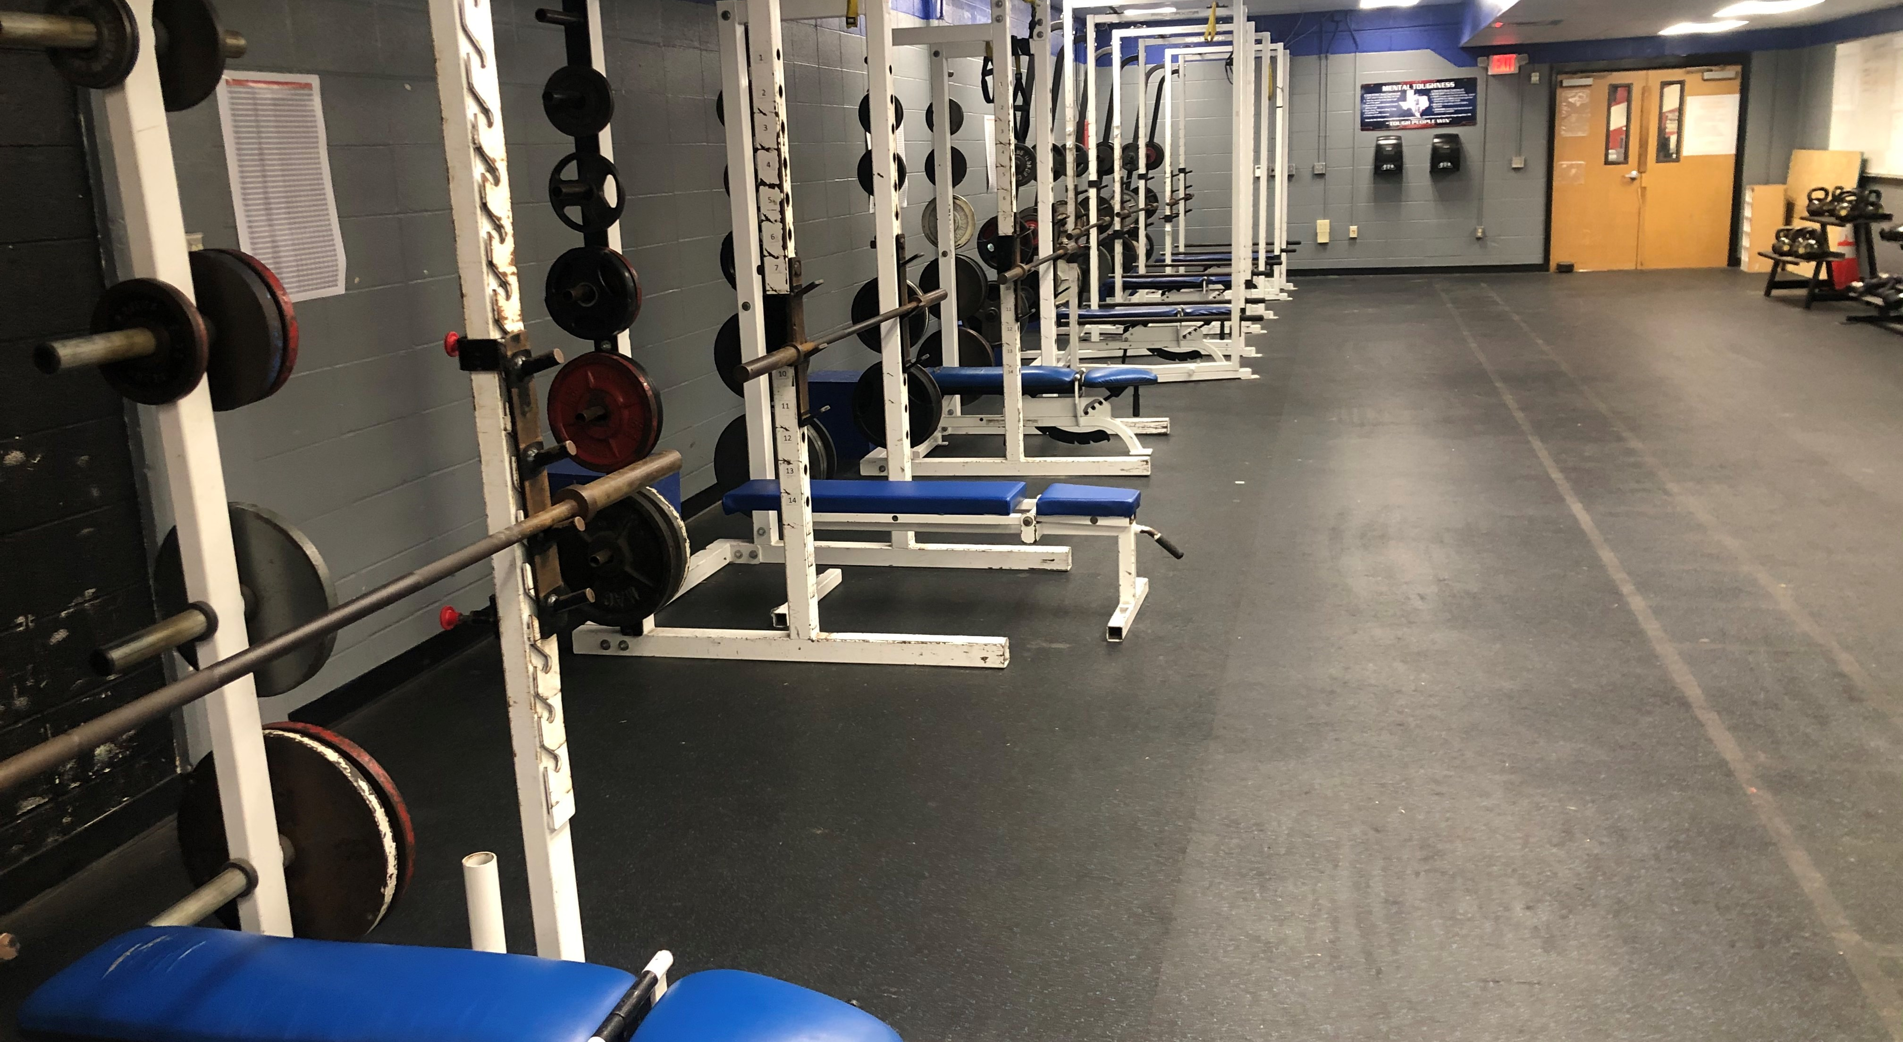

MINUTEMEN BOYS ATHLETICS
Upper Body Workout
Bench 3x12
Incline 3x12
High Pull 3x12
Lower Body Workout
Squat 3x12
RDL 3x12
Deadlift 3x12

