Slide 1





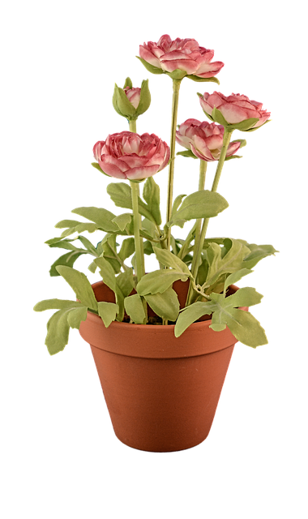


Today's Brainpop Lesson

