Slide 1

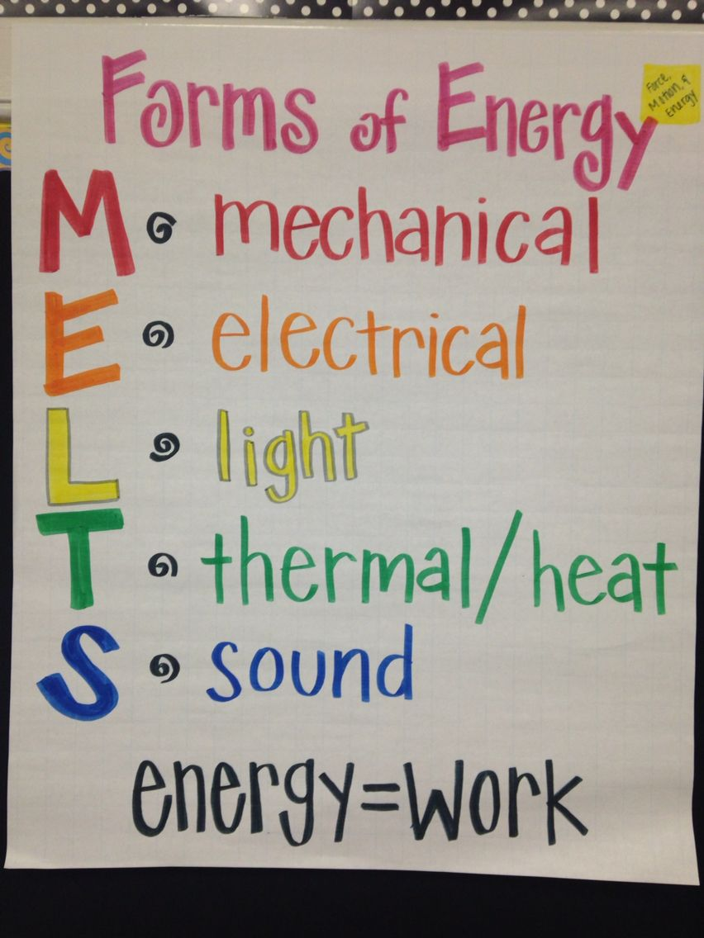
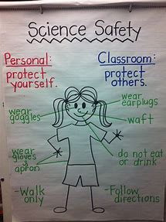


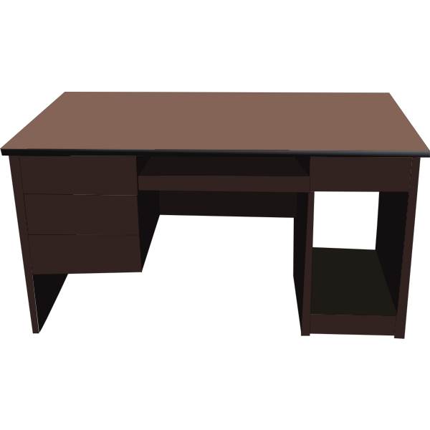






Welcome to
Mr. Lollis’
6th Grade
Virtual Science Classroom!
Today’s Forms of Energy Lesson

