Slide 1



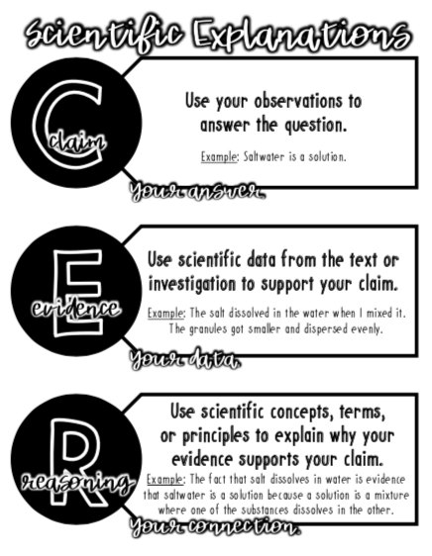


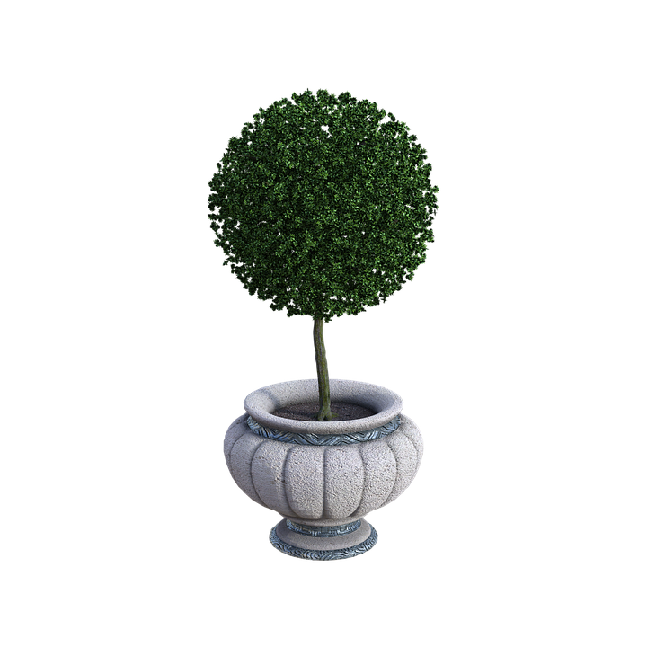
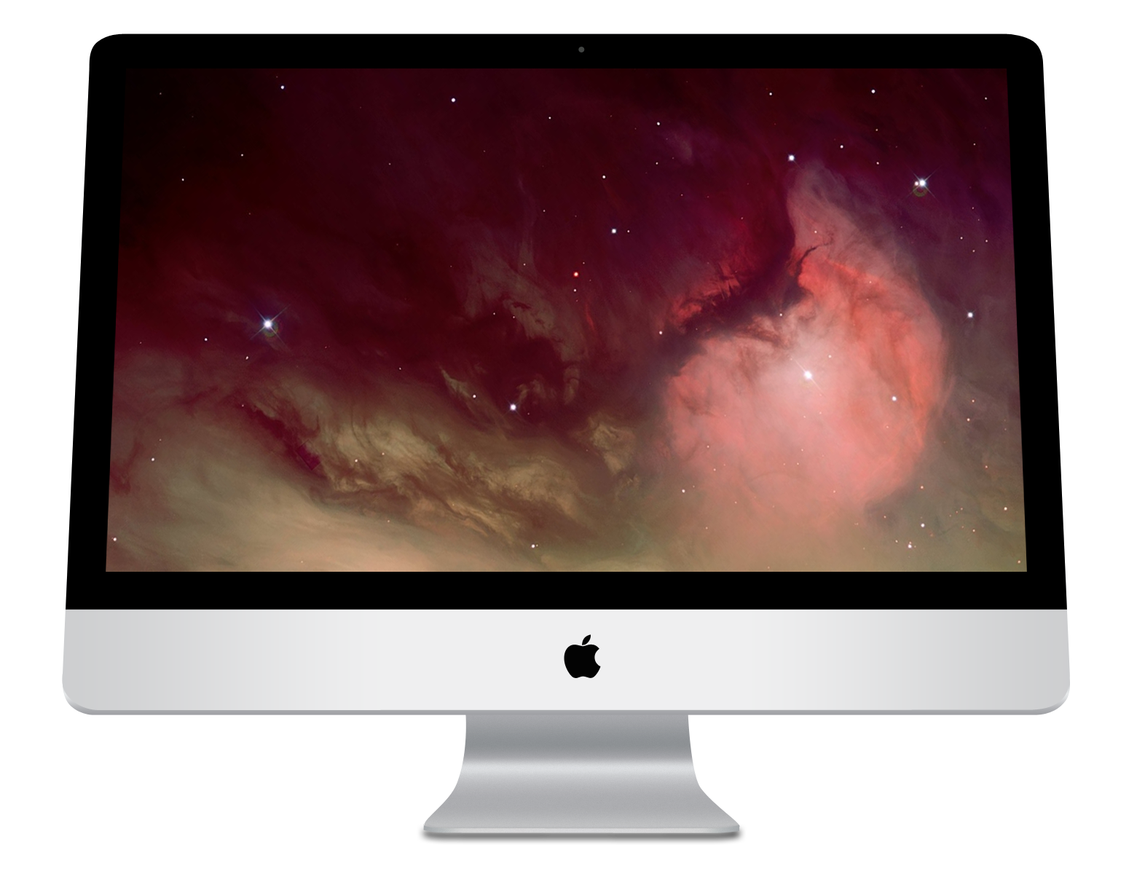

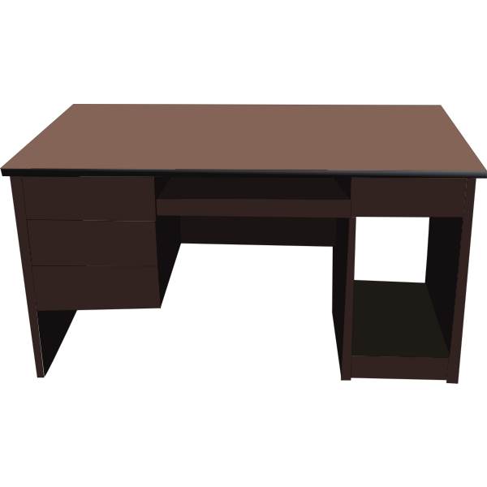

7th grade Science - Wednesday, May 27, 2020
Amoeba Sisters Natural Selection Video
Natural Selection PhET
Write a CER using this template!

