Slide 1




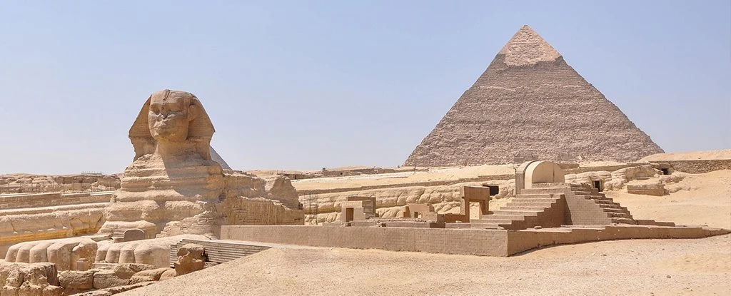

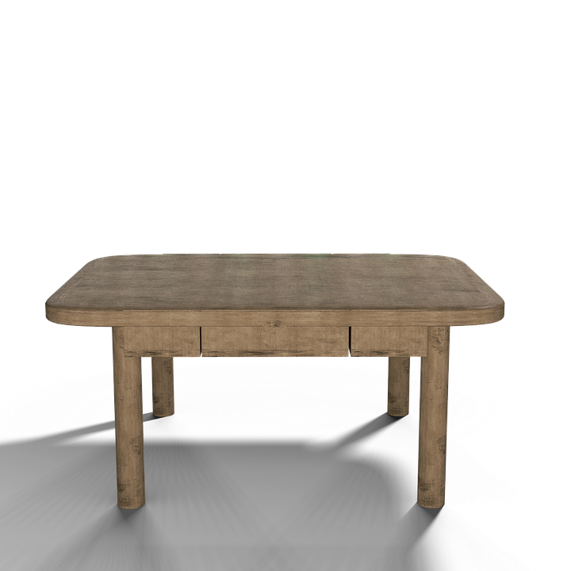

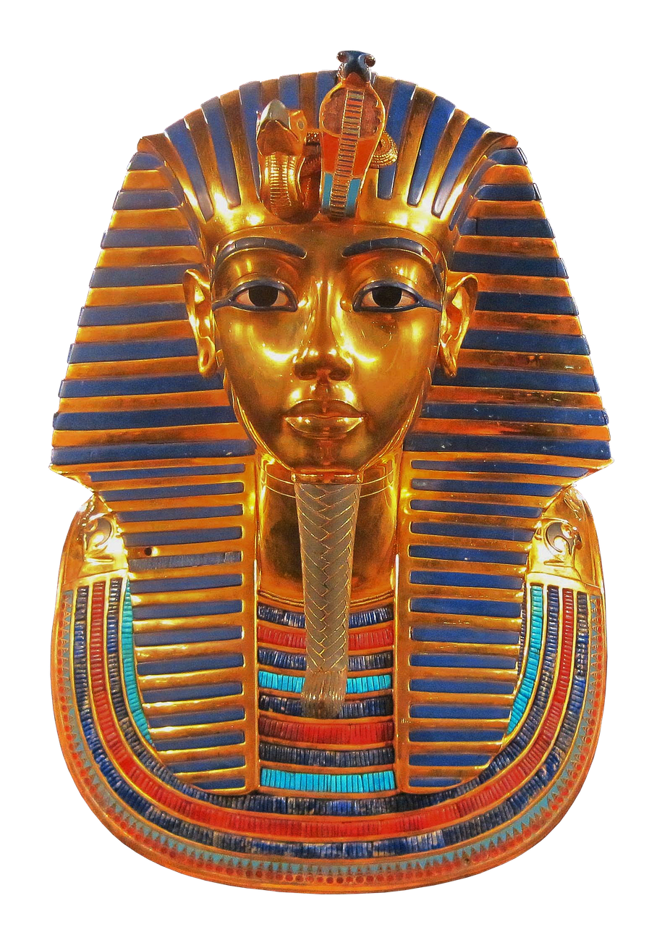

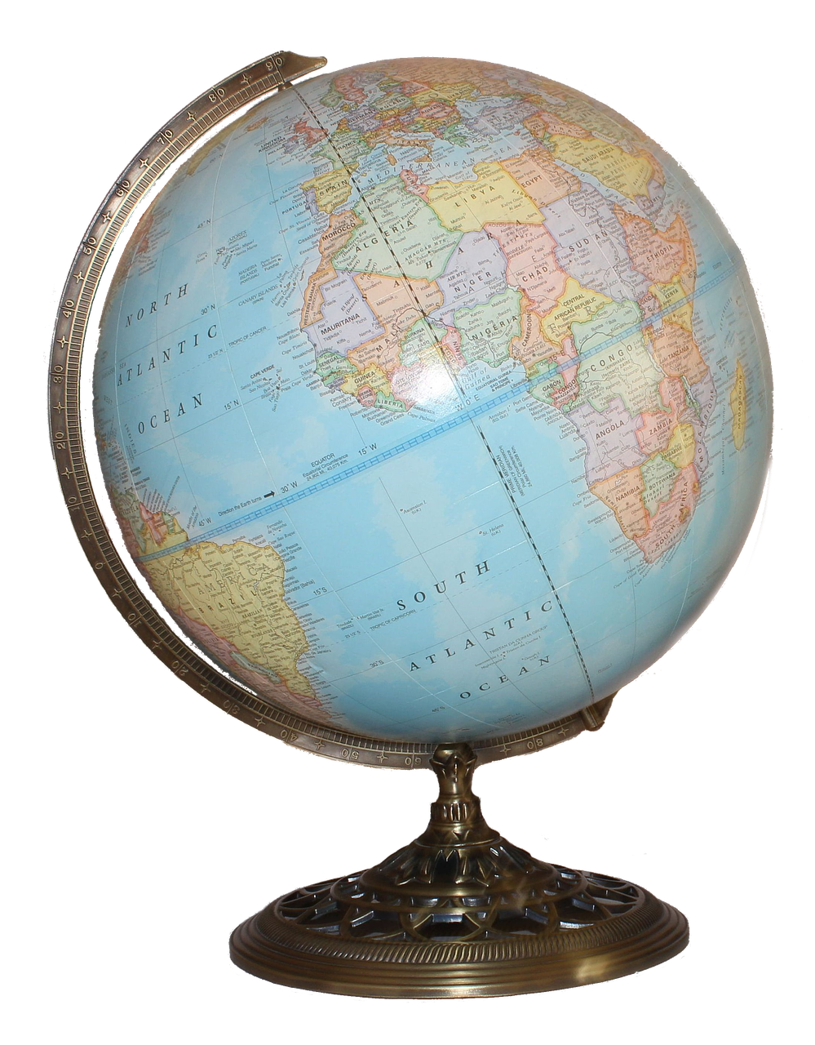


World Geography: learn about geysers and make your own predictions.
World History: Take a tour of Egypt at the Smithsonian Museum and describe the different types of mummies.
Explain the culture of San Antonio by exploring the Alamo.

