Slide 1






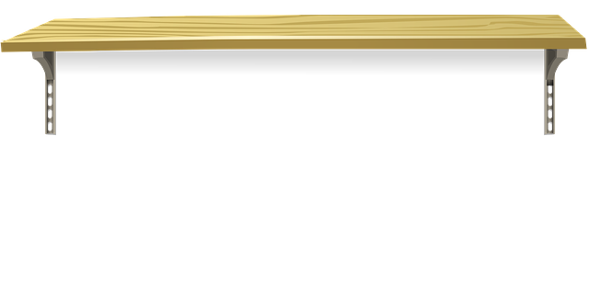








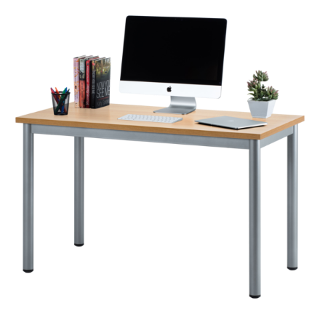

Welcome to Mrs. Messer's
Virtual Classroom
Click on the book title for your read aloud.
You can also find your own book on EPIC. Don’t forget to check Seesaw for your assignments

