Slide 1

Welcome!
Ms. Ortega - 6th Grade ELAR

Slide 2


May 27, 2020
Citing Text Evidence
Learning Objectives: Students will be able to use text evidence to prove their answers to comprehension questions

Slide 3
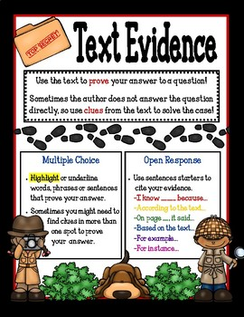
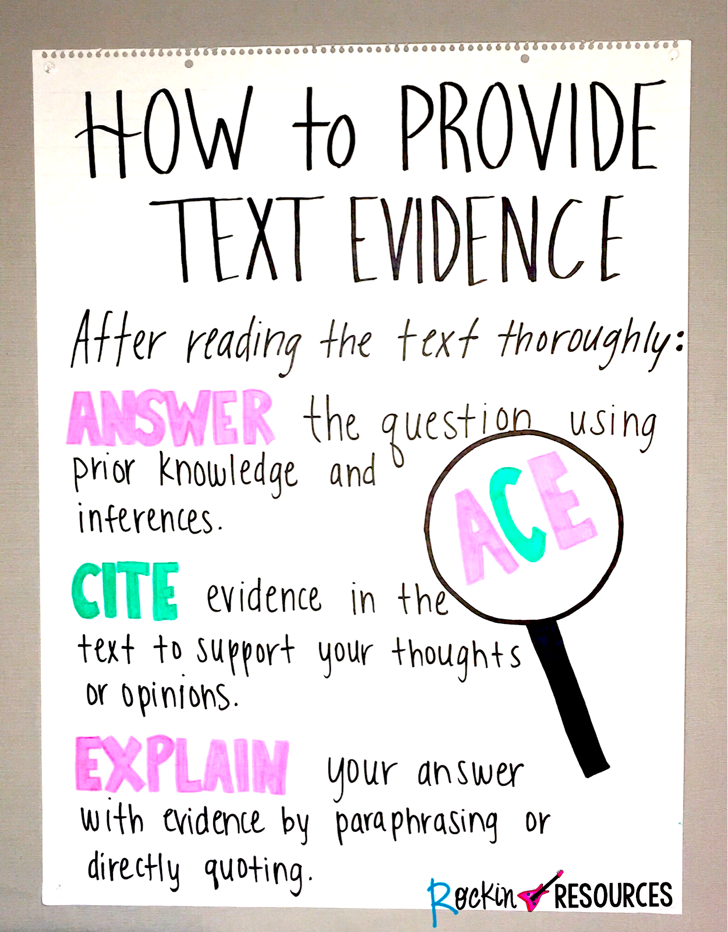
Citing Text Evidence

Slide 4
ARTICLE OF THE DAY: A Different Kind of Toy
Instructions: Read and Analyze article by citing text
Evidence
Click on the link below
www.achieve3000.com

Slide 5
Character Strong Activity
Kindness Journal Day 1
Click on link for instructions
Please submit Journal Entry in your assigned TEAMS .
https://www.youtube.com/watch?v=IPzRnhza808

Slide 6
Reminders & Announcements
Spirit Week- May 25 - May 29
* Don’t forget to post your spirit pictures on Teams Class Page
Tutoring Hours: Monday - Friday
3:00 - 4:00pm

Slide 7
Reminders & Announcements
Don’t forget to visit GGMS website for the latest news and updates.
https://gusgarcia.eisd.net/

