Slide 1


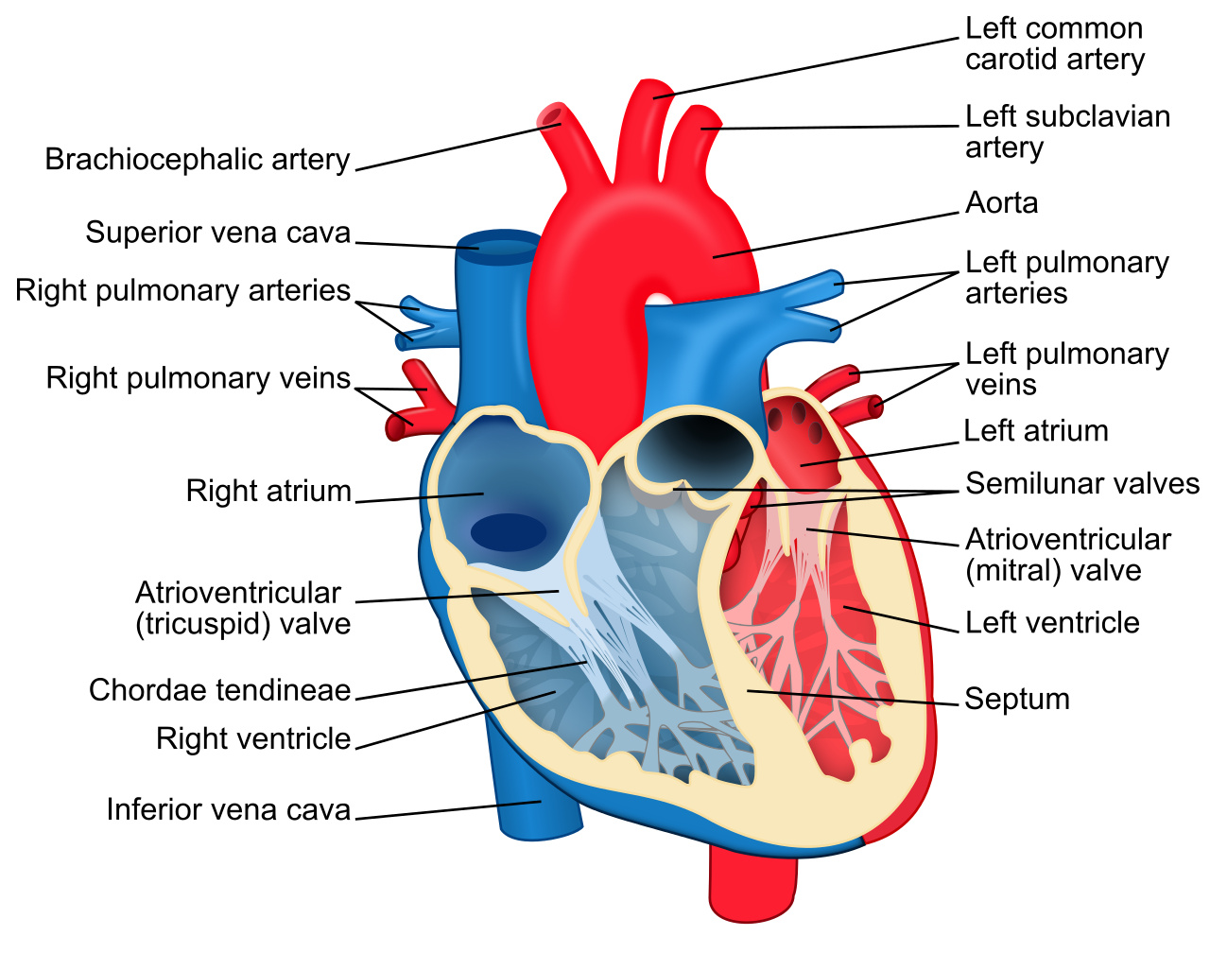

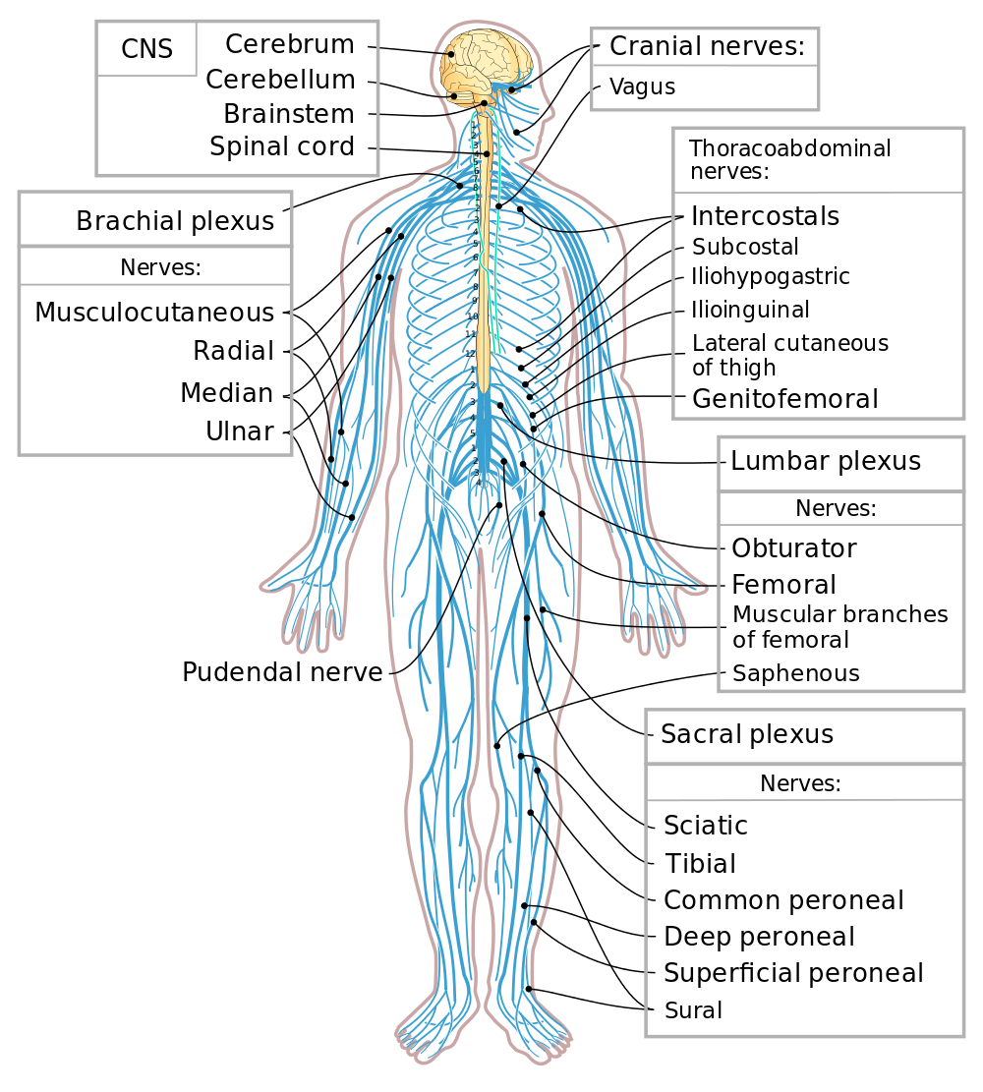




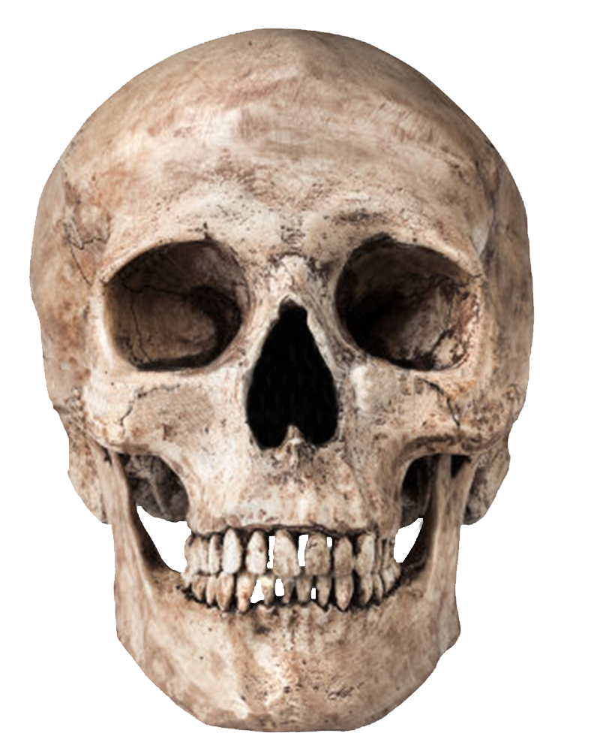




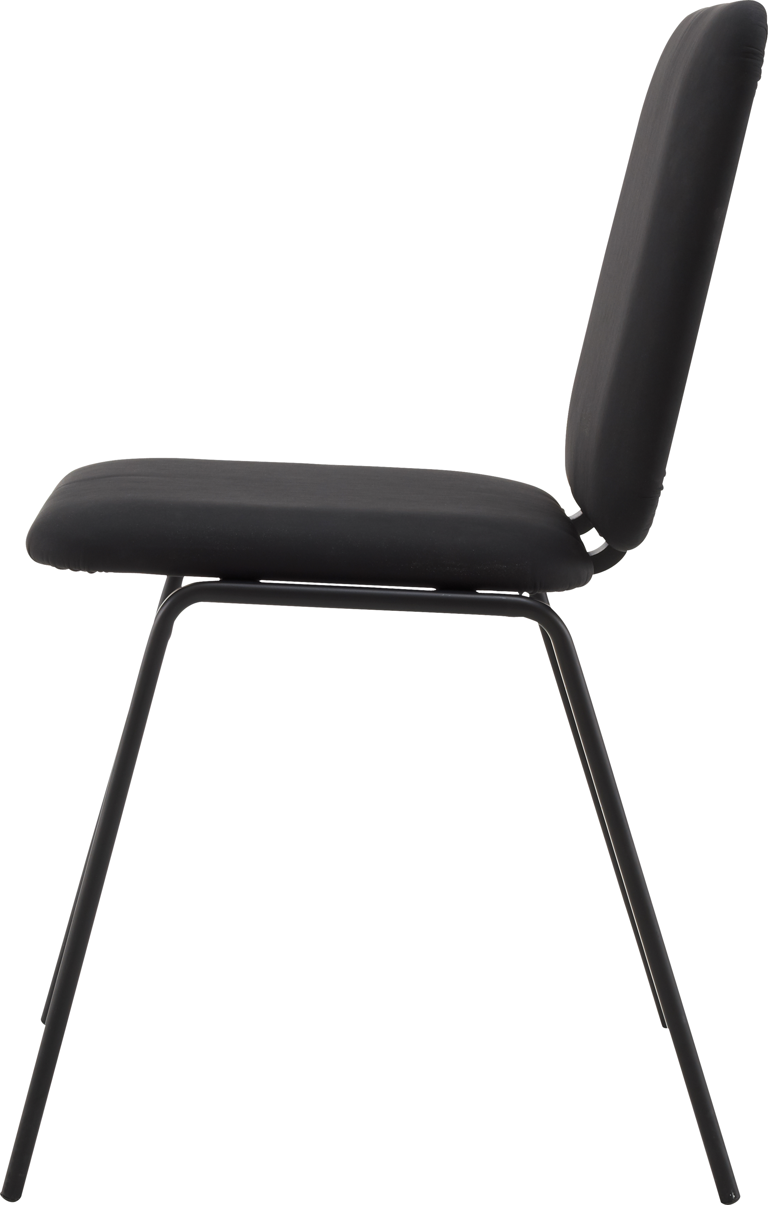

Welcome to Ms. Rodriguez's Health Science Theory and Medical Terminology Class. I am excited for the new school year and all the interesting skills we will learn.
This Photo by Unknown author is licensed under CC BY-NC.
This Photo by Unknown author is licensed under CC BY-NC.
This Photo by Unknown author is licensed under CC BY-NC.

