Slide 1
Psych Bitmoji
CLASS

Slide 2



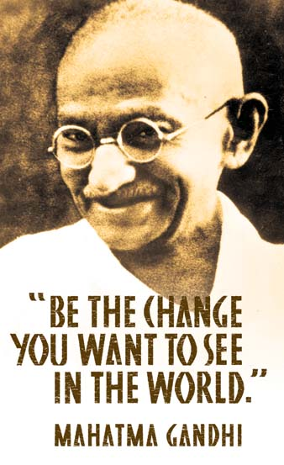



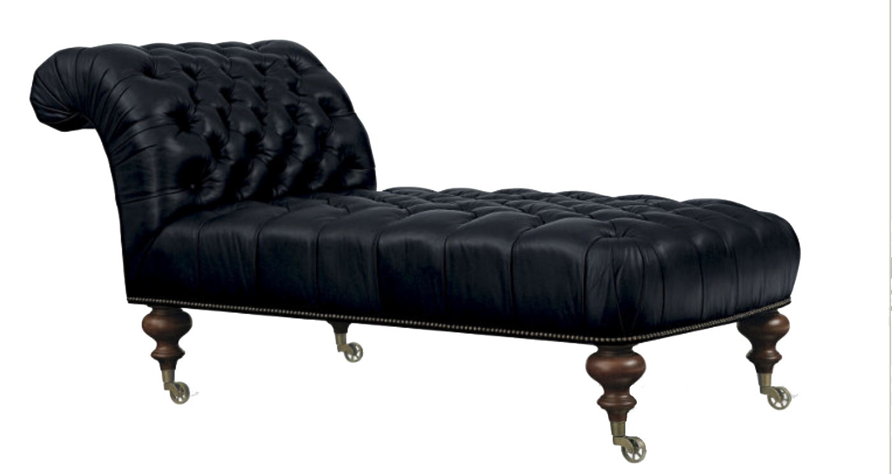


Welcome to PSYCH
Professor
SCHIBI
Dual Credit
This Photo by Unknown Author is licensed under CC BY-SA
This Photo by Unknown Author is licensed under CC BY-NC-ND
This Photo by Unknown Author is licensed under CC BY-NC
This Photo by Unknown Author is licensed under CC BY-NC
This Photo by Unknown Author is licensed under CC BY-NC

