Slide 1

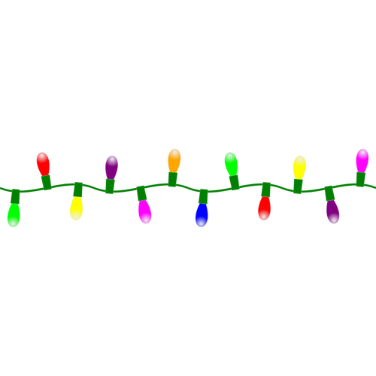
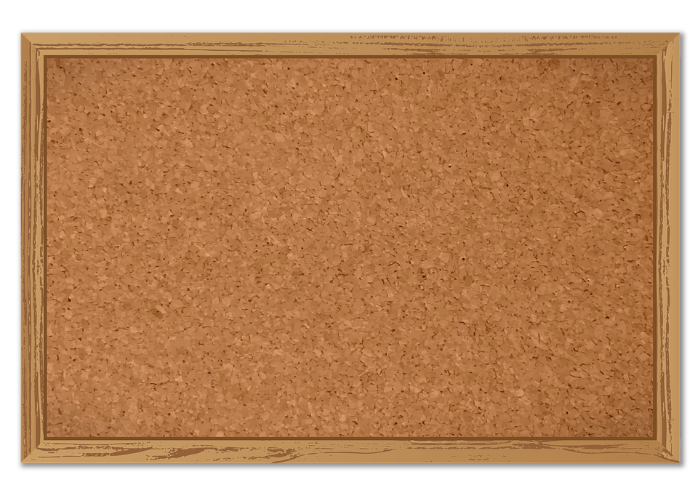






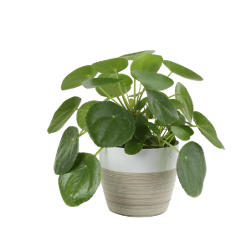


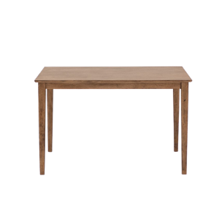


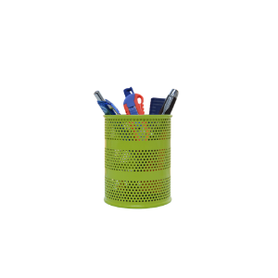


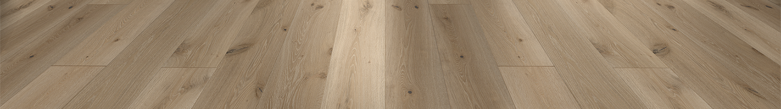

Date:
TODAY’S
Aug 17
Agenda:
Virtual
Routines
&
Procedures
Know:
Mrs. Rivera
Geometry
Routines/
Procedures
Understand:
WELCOME
BACK!
Task Card
Pre-Assessment
Be Able To:

