Slide 1



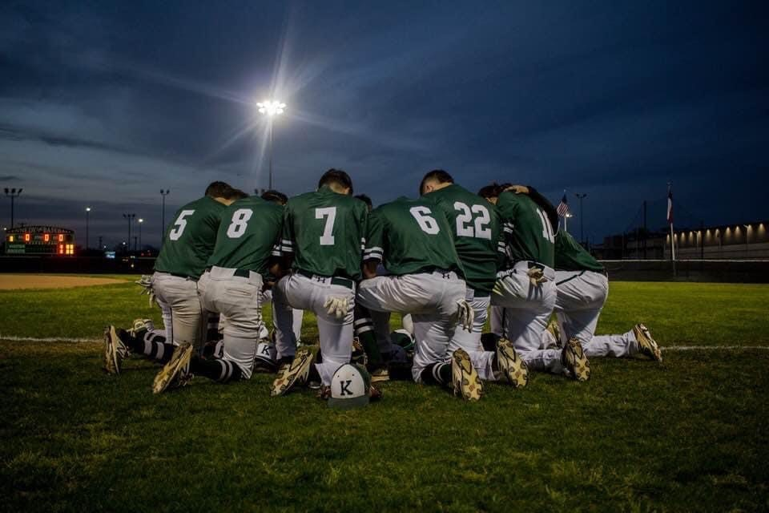
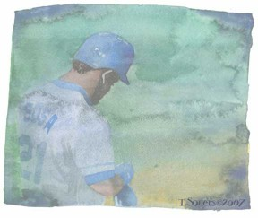

Welcome to
Coach Olivarez’s Class
Don’t just wish for it, work for it!
This Photo by Unknown Author is licensed under CC BY-NC-ND

