Slide 1
The Fundamentals of Paraphrasing and Summarizing
Keli Bradbury ktbradbury@radford.edu
&
Dana McCaleb dmccaleb@vt.edu
Notes:
Teaches students how to translate information into their own words
strategies for finding the main idea and details of each paragraph
to generalize these strategies to standardized tests
Take a moment to look at the table of contents of the student manual. Jim Knight and his team at the University of Kansas were very intentional about the passages they gathered for each lesson. They’re all on about the 5th grade level. If your students are above or below this reading level you can find an appropriate replacement passage at the level of your students.
Go through the contents and show how each lesson builds on the next.
1

Slide 2
Agenda
Stages of Instruction
Strategy Description
Lesson Exploration
Scoring & Feedback
Troubleshooting
Notes:
Keli
2

Slide 3

Purpose & Rationale
Notes:
Keli
This is a reading strategy. This brings in vocabulary (understanding synonyms) and a comprehension strategy→if students are able to paraphrase and summarize then they’ll be better able to understand).
3

Slide 4
Research Results
The means for the NSWDs for pretest to posttest were
Pretest Posttest 69% 84% experimental group
70% 54% comparison group
• The means for the SWDs for pretest to posttest were Pretest Posttest 60% 80% experimental SWDs 62% 48% comparison SWDs
Notes:
Keli
Took place in 10th grade general education language arts classes; collab with and without disabilities; drop from pre- to post-test for comparison group was due to increased criteria for post-test (note that the experimental group still met the higher expectations); 11 total lessons from pre- to post-test
4

Slide 5
8 Stages of Instruction
Pretest & Make Commitments
Describe the Strategy
Model
Verbal Practice
Controlled Practice and Feedback
Advanced Practice and Feedback
Post-test & Commitments
Generalization
Notes:
Keli
Pre-Test- can change reading passage but must have at least 400 words and be on grade level (answer sheet is on appendix B, pg 105 to find main ideas)
If the student(s) are reading significantly below grade level, read the passage to them–not evaluating comprehension–evaluating ability to find main idea and supporting details.
Commitments-helps students to facilitate their learning
Model– will follow the “I do, we do, you do” show a Learning Sheet from Student Book (pg. 2) “Learn by Watching”, “Learn by Sharing”, “Learn by Practicing”
Verbal Practice provides students with the opportunity to articulate what they’ve learned. They’ll be given a prompt like, “What are the three characteristics of a good paraphrase?” and they’ll respond, “It must have the same meaning, it must be in our own words, and it must make sense.”
Controlled Practice and Feedback is during the Learn by Sharing and Practicing piece while the Advanced Practice and Feedback happens when students are able to generalize the information to other courses/information.
Post Test to observe changes/improvements/outcomes from the strategy.
5

Slide 6
Two Terms
Paraphrasing
Summarizing
a restatement of a text, passage, or work giving the meaning in another form (Merriam-Webster 2008)
completely rewritten passage in one’s own words and style; usually about the same length as the original (Elements of Literature 2005)
putting information into your own words (Schumaker, et al 2007)
an abstract, abridgment, or compendium especially of a preceding discourse (Merriam-Webster 2008)
highly condensed writing; 1/4 - 1/3 the length of the original (Elements of Literature 2005)
Generation of “… external products that students create for themselves in order to reduce and organize information for their subsequent study and review.” (Simpson & Nist 2000)
Notes:
Keli
It’s important for students to understand the difference between these two terms. This strategy will support this student understanding.
6

Slide 7
Pretest: (pp. 9-11)
Have students find and paraphrase the main idea and details of a reading passage using:
•
·The Pretest Passage from the manual
(p. 1 in the Student Materials Volume)
·
OR
· A reading passage containing about 400 words written at the student’s grade level
PLUS
•The Paraphrasing Sheet (p. 105)
Notes:
Keli
7

Slide 8
Pre-Test Scoring Instructions
For most of the learning sheets in the student manual, scoring is based upon whether an item is:
correct,
written in the student’s own words, and
makes sense.
Notes:
Keli
See Appendix A: Evaluation Guidelines

Slide 9
“Correct”
an item has the same or similar meaning as the original word or phrase, or
it accurately states a paragraph’s topic, main idea, or detail
If an item meets this criterion, place a checkmark in the “C” box.
Notes:
Keli
9

Slide 10
“Written in the Student’s Own Words”
an original word, phrase, or sentence has been changed into the student’s own words as much as possible
Remember, not all words in a phrase or sentence can be changed
If an item meets this criterion, place a checkmark in the “O” box.
Notes:
Keli
10

Slide 11
“Makes sense”
an item is not garbled but can be understood by another person
If an item meets this criterion, place a checkmark in the “M” box.
Notes:
Keli
11

Slide 12
Practice with Scoring
Mastery Requirement: 80% of whole class and 90% of regular attendees earn at least 80%
Pre-test:
Mother Teresa: Inspiring the World to Love
Notes:
Keli
12

Slide 13
Lesson 1: Paraphrasing Words (pp. 12-17)
Define paraphrasing
Provide characteristics of a good paraphrase
Define synonym
Notes:
Keli
13

Slide 14
Paraphrasing (Cue Card 1)
Paraphrasing means putting information into your own words.
You can paraphrase:
A single word
A phrase or group of words
A whole sentence
A whole paragraph
A whole page
Notes:
14
Keli
Cue Card#1

Slide 15
A Good Paraphrase (Cue Card 2)
A paraphrase must be CORRECT.
A paraphrase must include ONE’S OWN WORDS.
A paraphrase must MAKE SENSE.
.com
Notes:
15
Keli
Cue Card #2

Slide 16
Synonym (Cue Card 3)
A synonym is a word that has the same meaning or a very close meaning to the original word.
Examples:
A synonym for pretty is lovely.
A synonym for starving is famished.
A synonym for purple is amethyst.
A synonym for automobile is car.
Notes:
16
Keli
Cue Card #3

Slide 17
Lesson 1: Practice w/Synonyms (pp. 14-16)
1. Conduct the Learn-by-Watching Activity
Demonstrate finding synonyms.
Put each word in a sentence.
Replace the word with a synonym in the same sentence.
Check whether the sentence means the same thing.
2. Conduct the Learn-by-Sharing Activity
Students work with the teacher on the next five words.
3. Conduct the Learn-by-Practicing Activity
Students practice finding synonyms for five words on their own.
Notes:
17

Slide 18
Learn by Watching We learn best through the process of imitation!
Review
Explain how it will help
Specify what they need to do
Think out loud
Problem solve
Attack the challenge in different ways

Slide 19
Learn by Sharing We can try it out and give each other feedback!
Review
Ask students to explain how they’re thinking
Shape student responses
Encourage
Evaluate
Re-instruct, if necessary

Slide 20
Learn by Practicing We can practice to build confidence and fluency in performing the new skill!
Let students do it on their own
Give brief, specific feedback
Coach those who need the most help
Identify categories of error
Have students plot their progress

Slide 21
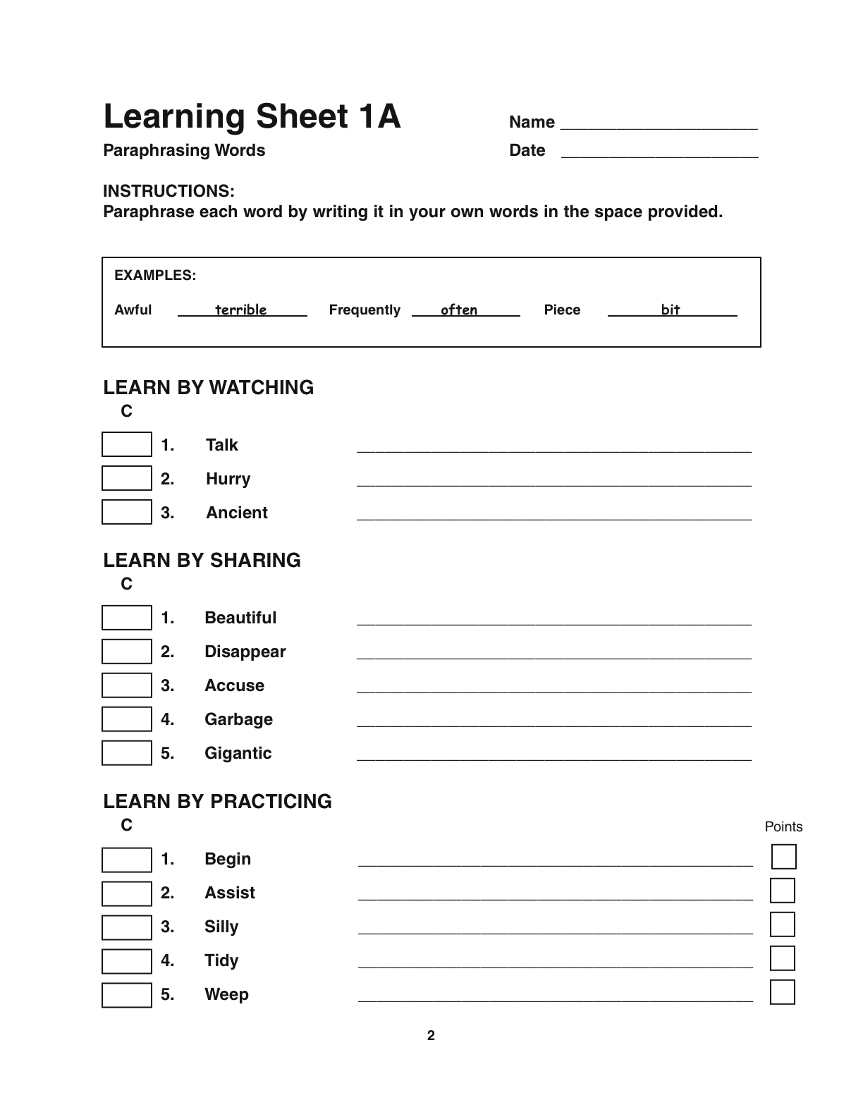
Notes:
21

Slide 22
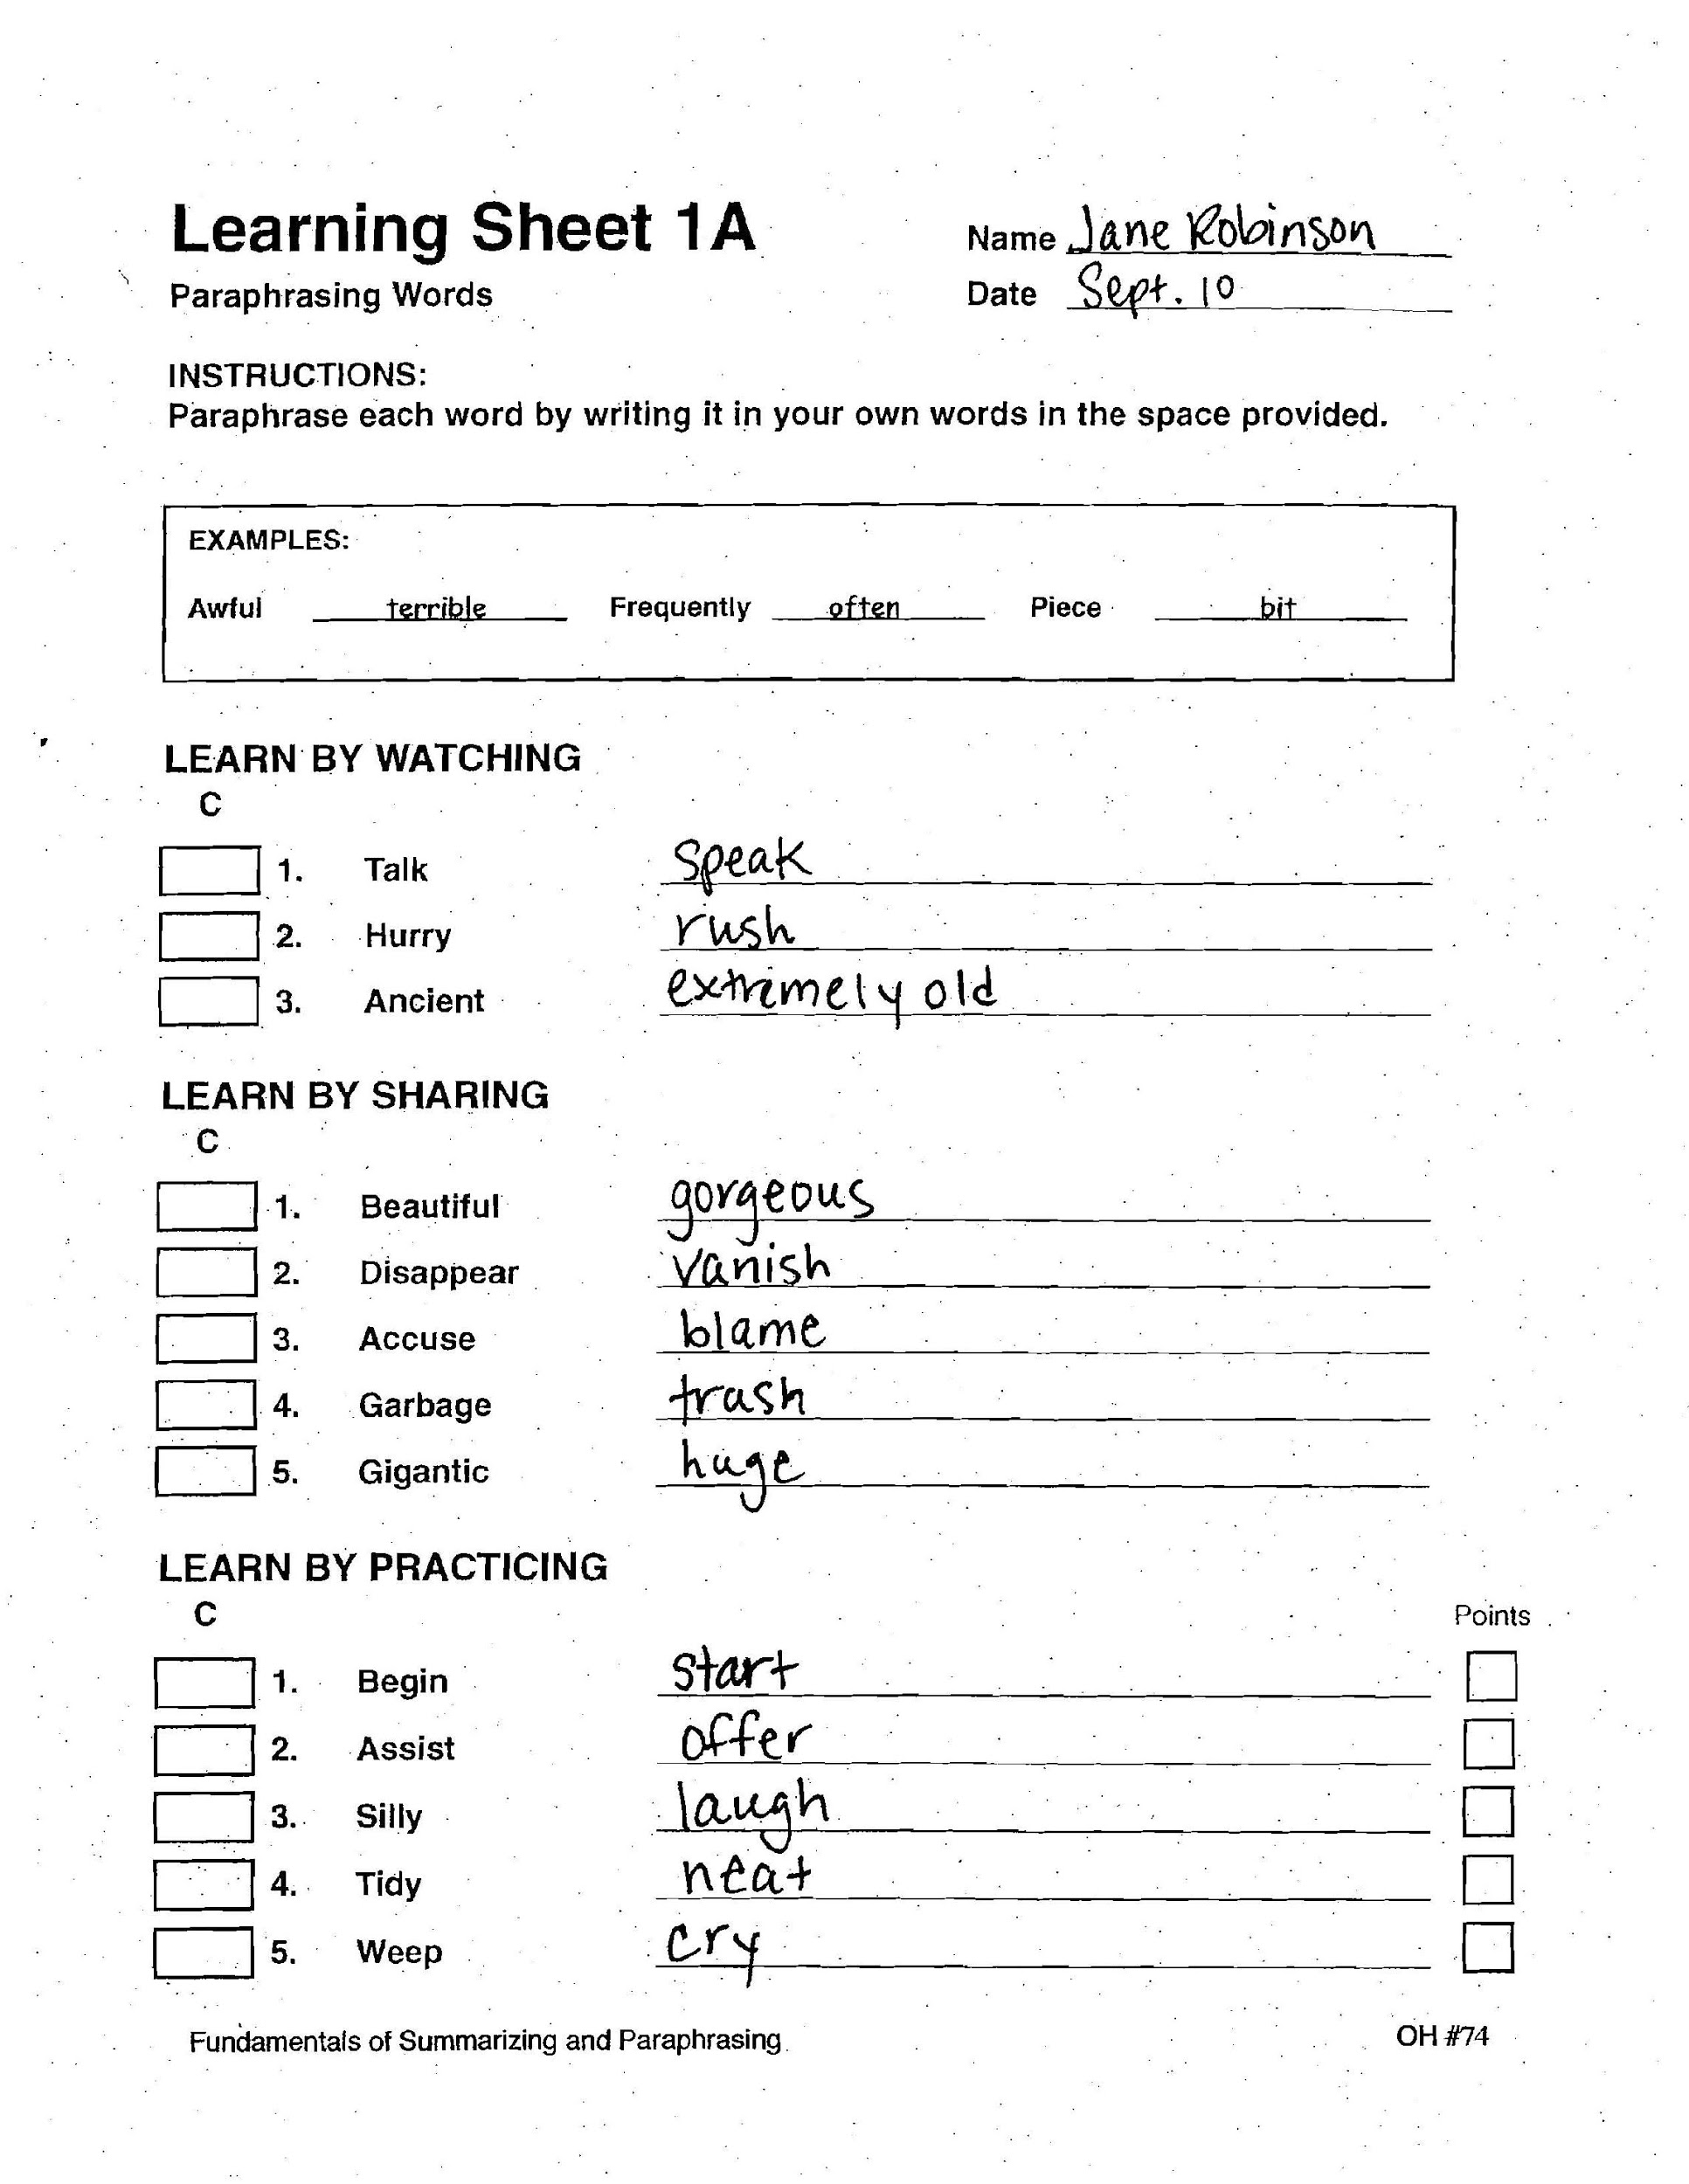
Notes:
22

Slide 23
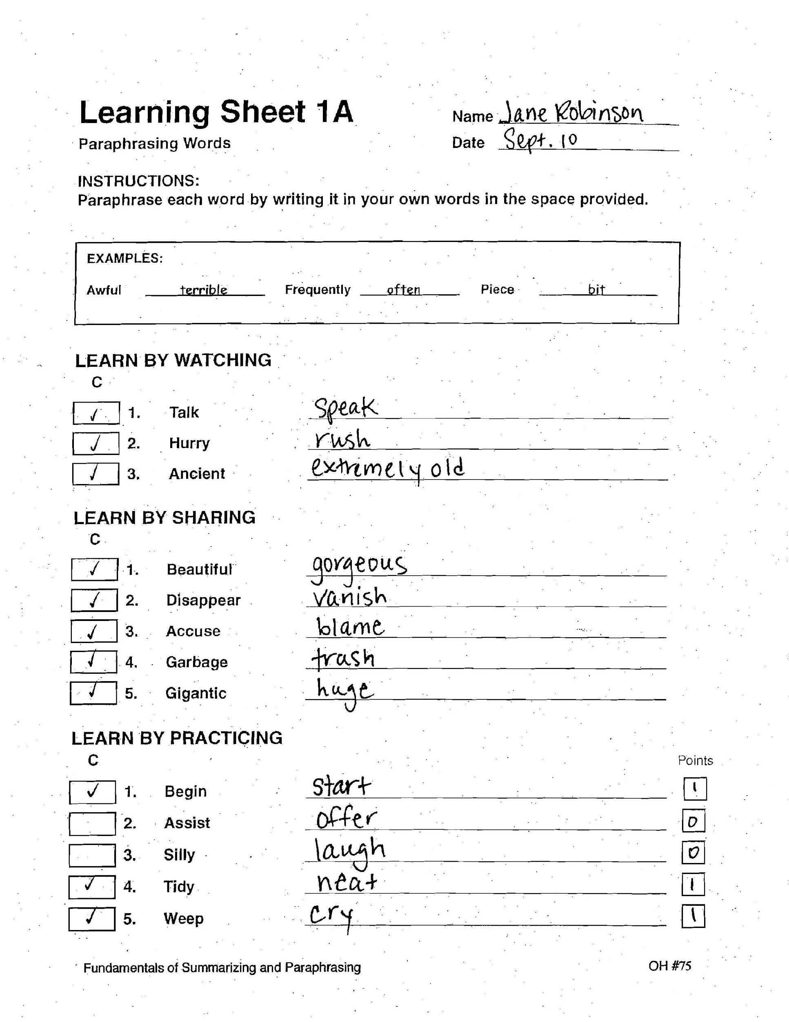
Notes:
Dana
4 points or 80% is mastery
23

Slide 24
Note!
Mastery Learning
Post organizer after each lesson
Review Lesson
Preview Next Lesson
Plan the next lesson section
Scoring directions (Page 81)
Notes:
Keli
Mastery has to be 80%
24

Slide 25
Paraphrasing Phrases Lesson 2 (pp. 18-22)
To define phrases
To ensure that students master paraphrasing phrases
Notes:
Keli
25

Slide 26
Phrase (Cue Card 4)
A phrase is a small group of words
that has meaning.
Examples:
under the couch
wooden house
along the avenue
before the game began
Notes:
26
Keli
Cue Card #4

Slide 27
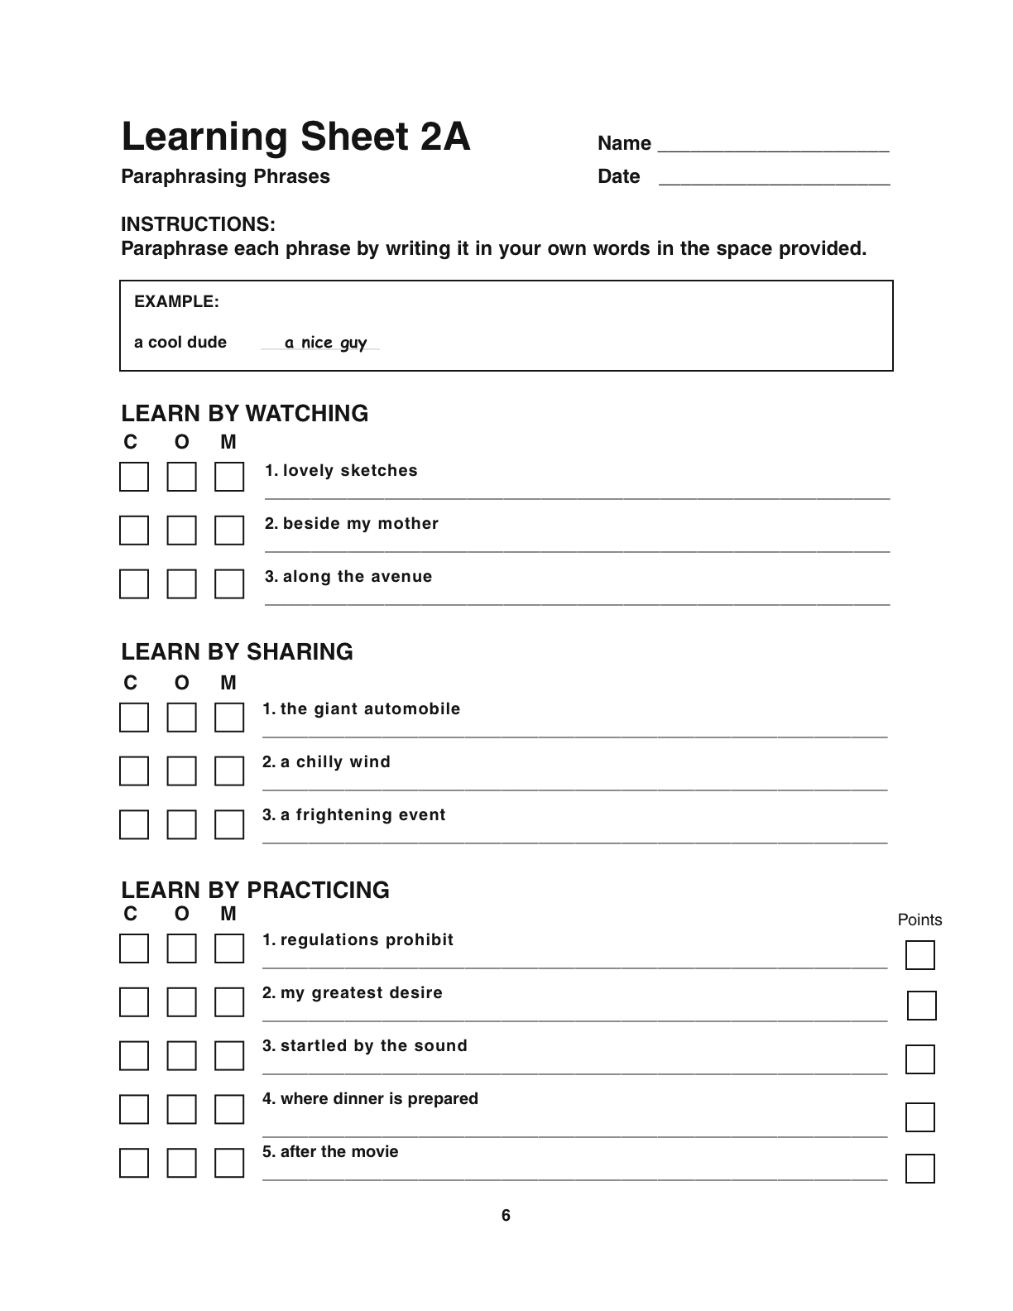
Learning Sheet 2
Notes:
Keli

Slide 28
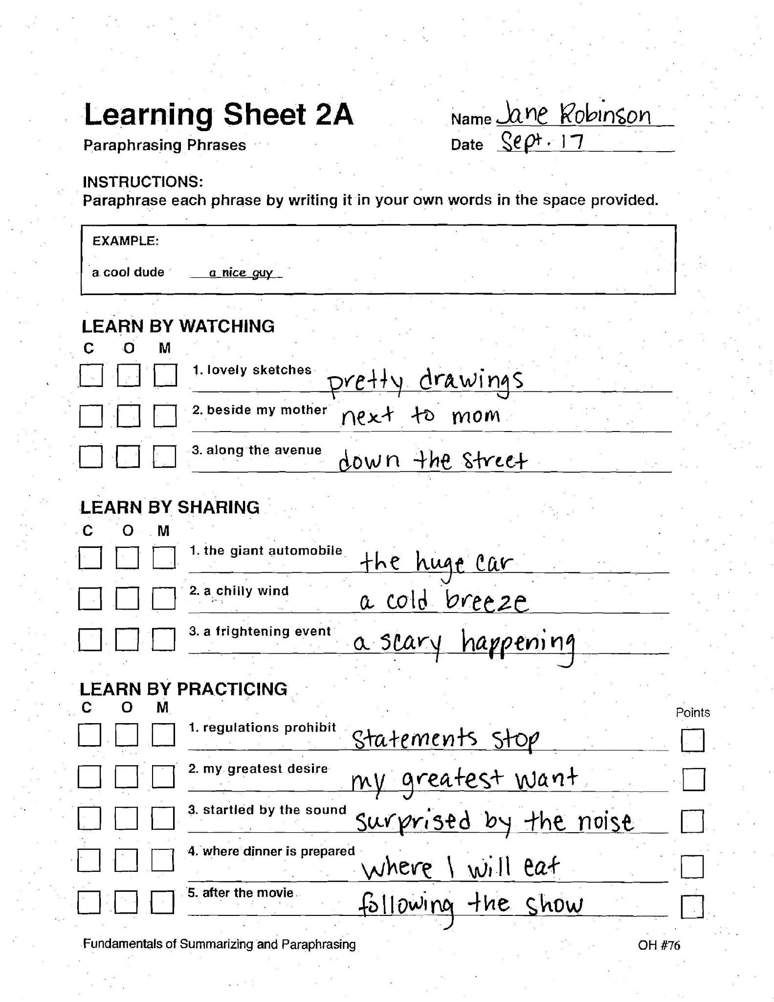
Student Example
Notes:
Keli

Slide 29
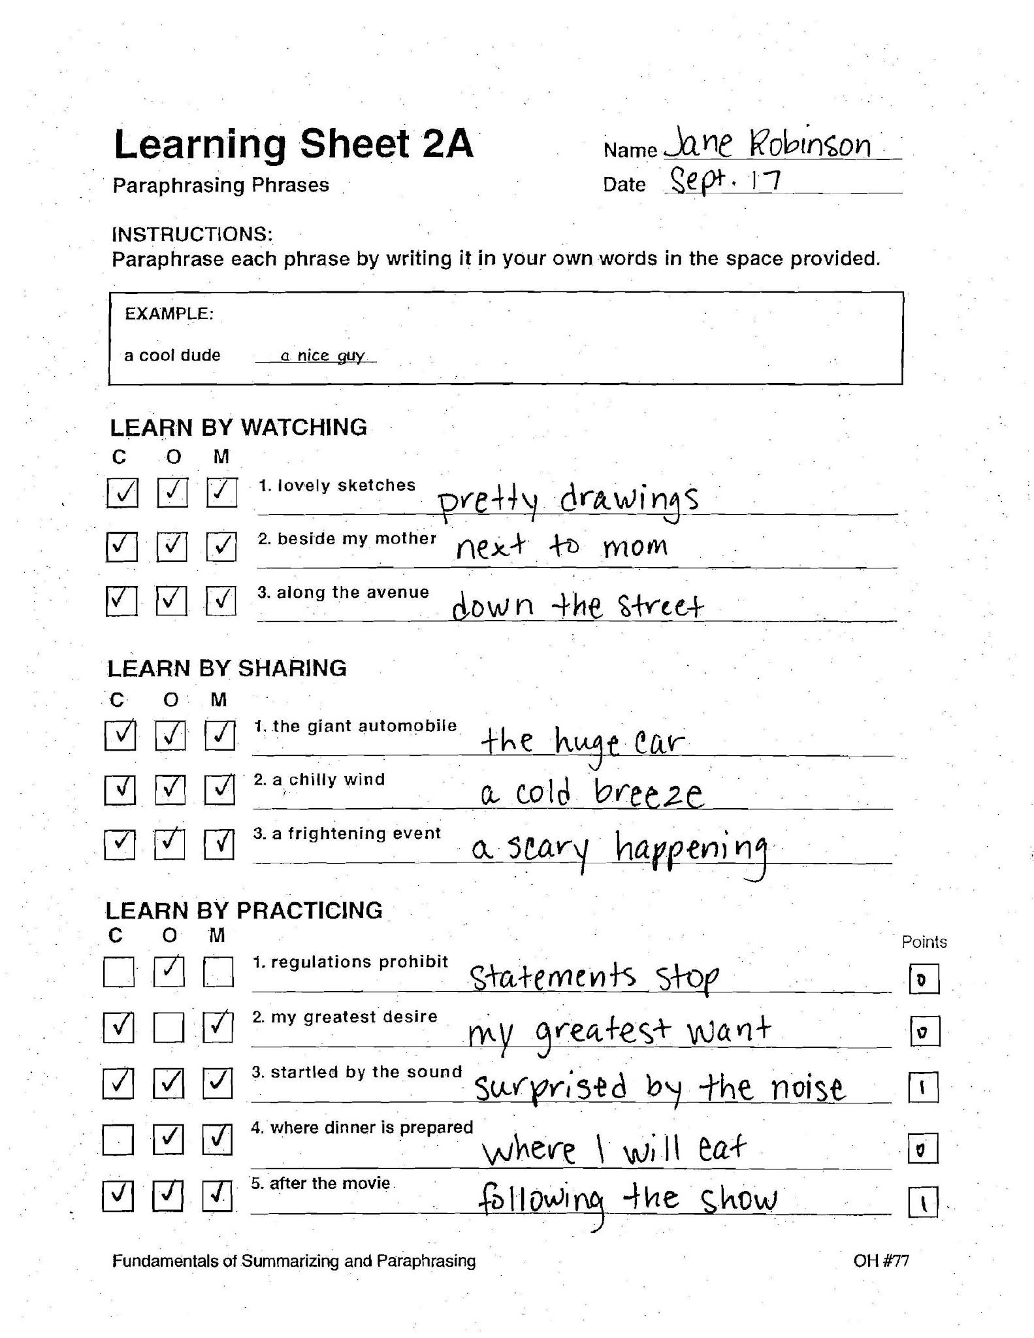
Scoring Example
Notes:
Keli

Slide 30
Lesson 3
PRACTICE WITH SENTENCES
In Lesson 3, you will:
∙ Conduct the Learn-by-Watching Activity
⮚ Demonstrate paraphrasing three sentences.
▪ Break each sentence into parts.
▪ Paraphrase each part using synonyms.
▪ Put each paraphrase back into the sentence to check it.
∙ Conduct the Learn-by-Sharing Activity
⮚ Students work with the teacher on the next three sentences.
∙ Conduct the Learn-by-Practicing Activity
⮚ Students practice paraphrasing five sentences on their own.
Notes:
Dana

Slide 31
Lesson 3
Define a sentence
Paraphrase single sentences
(pages 23-27)
Notes:
Dana

Slide 32
Sentence
A sentence is a group of words that:
Has a subject and a verb
Begins with a capital letter
Has a period or end punctuation
Makes sense
Examples:
We found the book under the couch.
The wooden house was very old.
Bicyclists rode along the avenue.
Mike ate dinner before the game.
(Cue Card 5)
Notes:
32
Dana
Cue Card #5

Slide 33
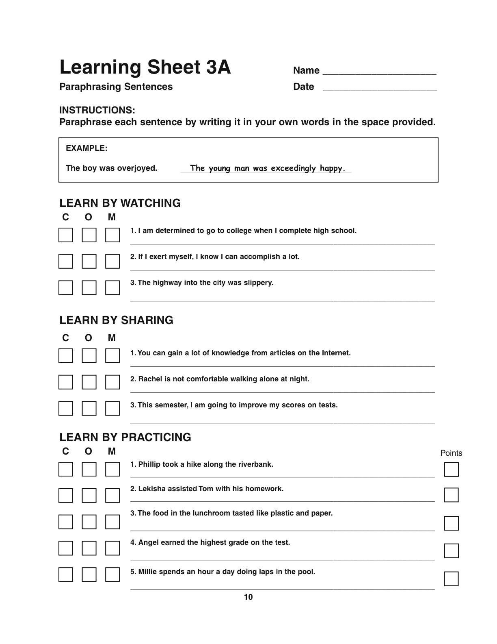
Learning Sheet 3

Slide 34
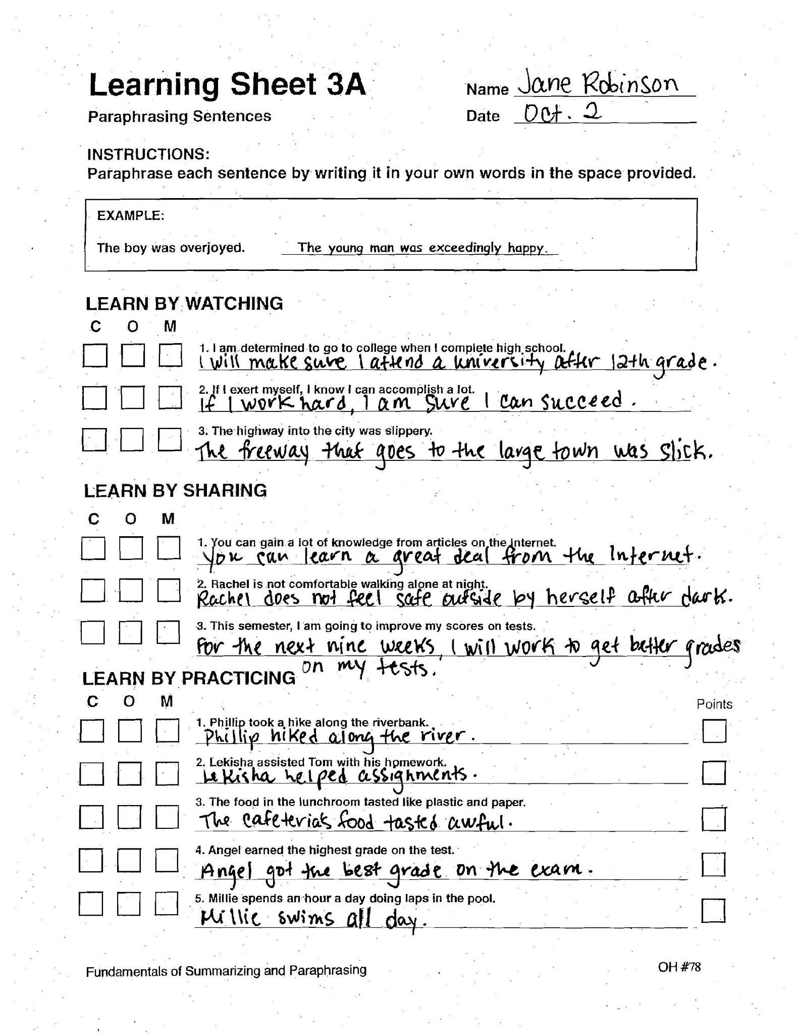
Student Example

Slide 35
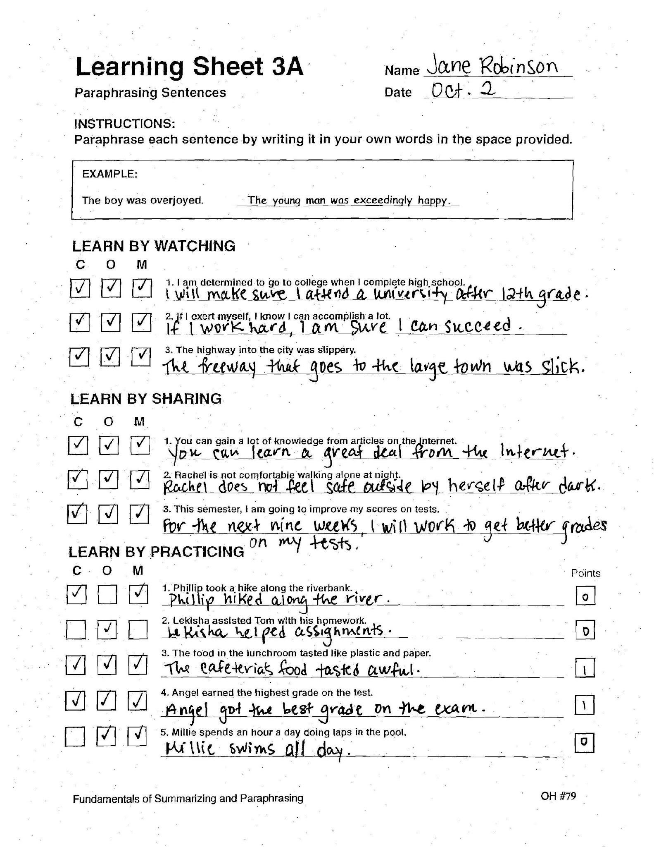
Scoring Example

Slide 36
Lesson 4
Define topic of a paragraph
Define the main idea of a paragraph
Define the details of a paragraph
Identify topics, main ideas, and details in a list
(pages 28-34)

Slide 37
Paragraph
A paragraph must:
Be indented at the beginning
Contain sentences that are all related to each other
Contain a topic, a main idea, and some details
(Cue Card 6)
Notes:
37
Cue Card #6

Slide 38
Topic
A topic is:
One or two words that tell what a paragraph is about
Frequently located in the first (or second) sentence of a paragraph
Sometimes repeated throughout a paragraph
Sometimes found in the title above a paragraph
To find a topic, say:
“This paragraph is about ___,” and then fill in
the blank with the one or two words.
(Cue Card 7)
Notes:
38
Cue Card #7

Slide 39
Example Paragraph
Emily had done many things to get ready for her big performance in the play “Alice in Wonderland.” First, in a used clothing store, she had found the perfect costume to wear. Her dress looked just like the one in the book everyone had been reading. Second, she had practiced and memorized all her lines. She had worked at reading and rereading her lines every night. Finally, she attended every rehearsal and practiced with all the other actors. She knew exactly what would happen at any moment during the play. As you can see, by finding a great costume, memorizing her lines, and rehearsing, Emily had ensured that she would do a great job in her play.
(Cue Card 8)
Notes:
39
Cue Card #8

Slide 40
Main Idea
A main idea is:
The big idea that the paragraph is about
A general statement that summarizes all the information in the paragraph
To find a main idea, ask:
“What does this paragraph tell me
about the (the topic) ?”
(Cue Card 9)
Notes:
40
Cue Card#9

Slide 41
Detail
A detail is:
A piece of information that’s related to the main idea
A statement that provides specific information about the main idea and topic
To find a detail, ask:
“What’s one piece of specific information
about the main idea?”
(Cue Card 10)
Notes:
41
Cue Card #10

Slide 42
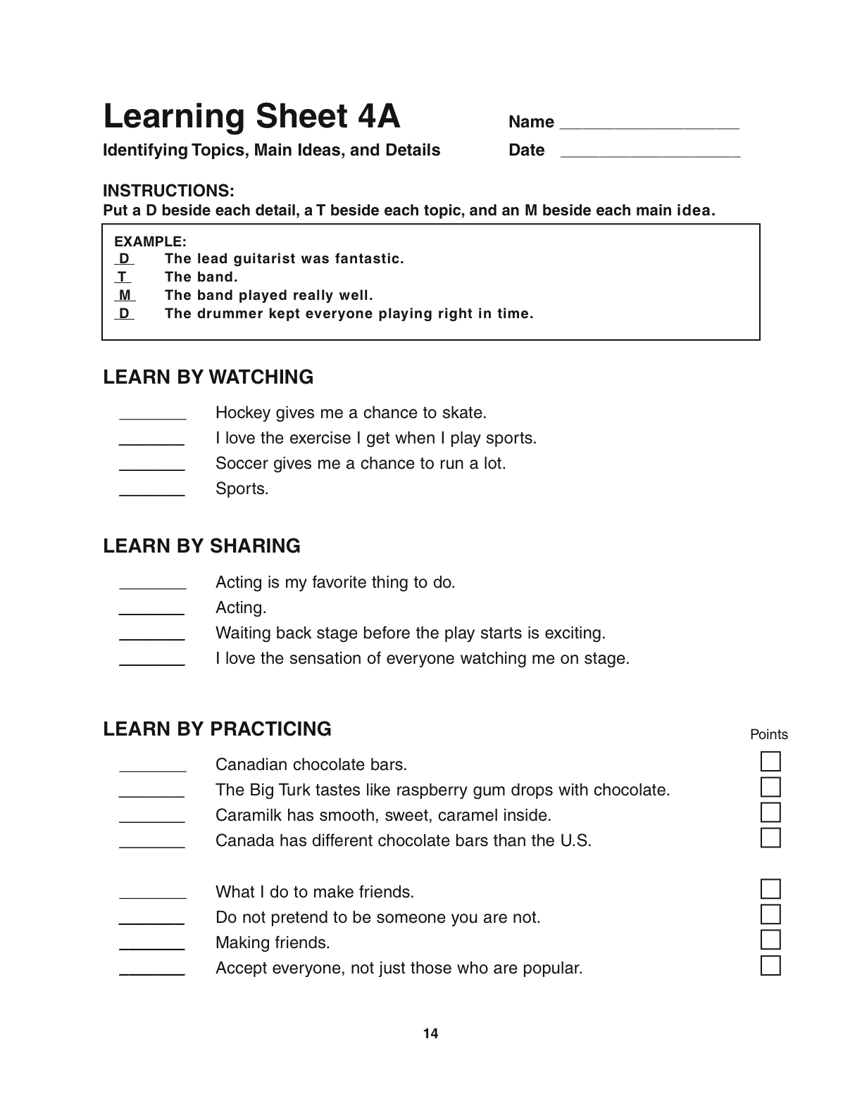
Learning Sheet 4

Slide 43
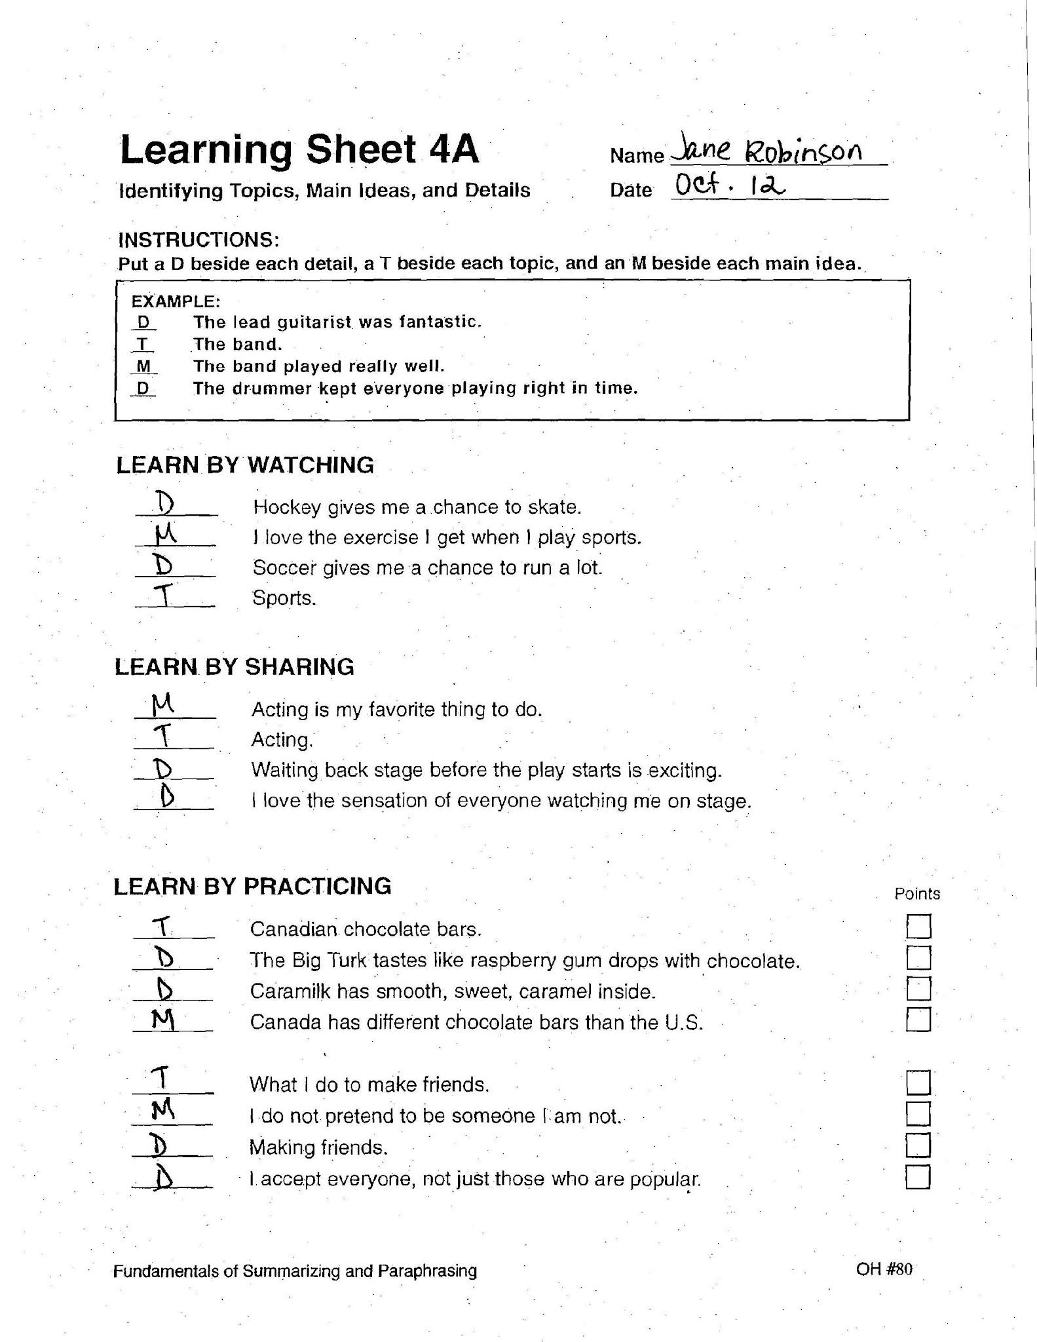
Student Example

Slide 44
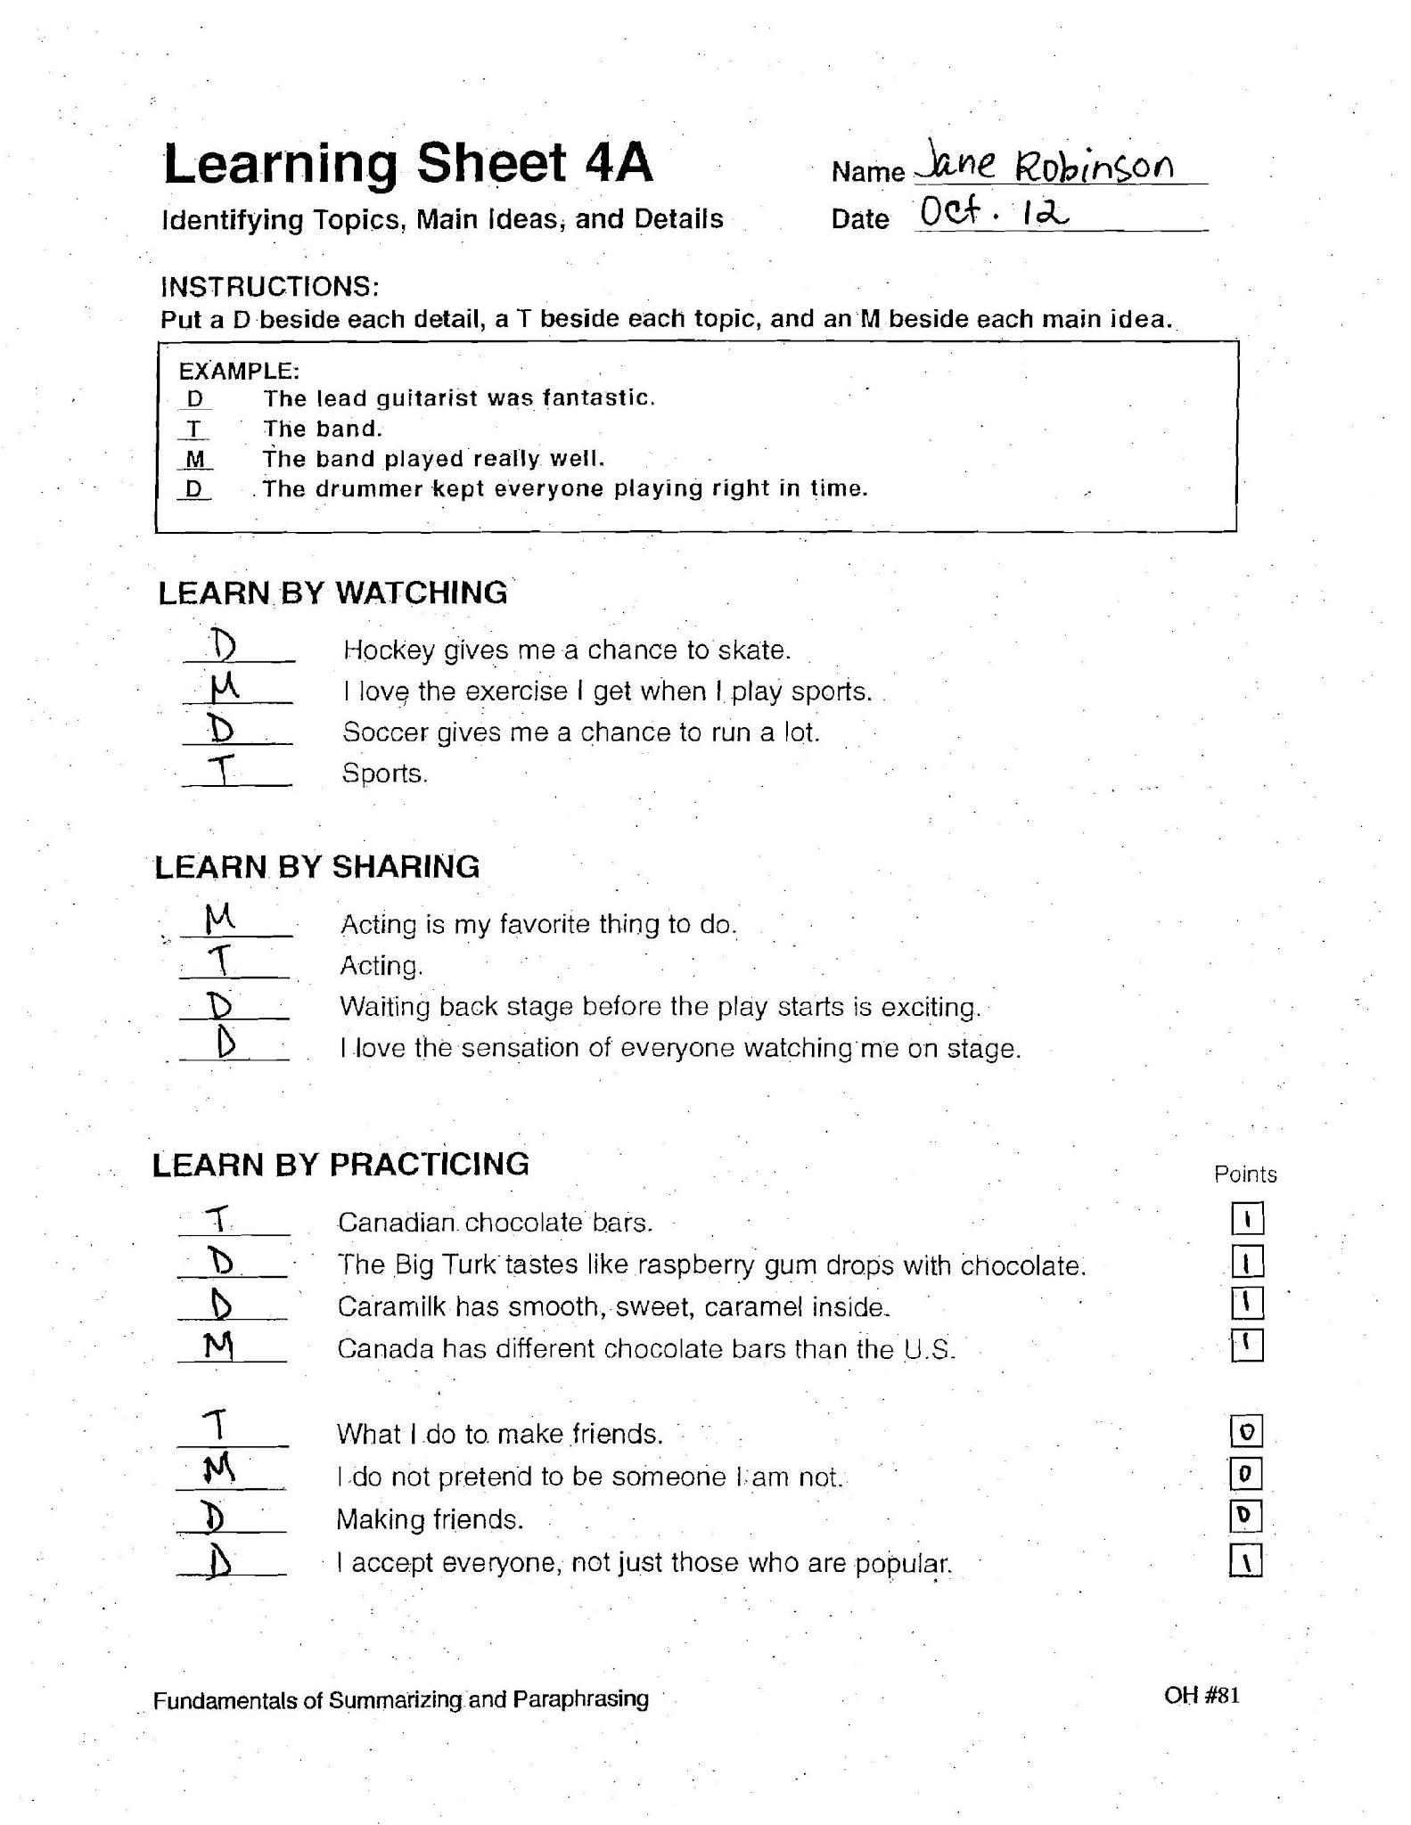
Scoring Example

Slide 45
Vocabulary Knowledge
Think, pair, share
What will you do when a student does not know the meaning of a word that they need to paraphrase to avoid giving him/her a synonym for the unknown word?
Glossary
Notes:
Dana
45

Slide 46
Post Organizer
Q & A
Coaching Services
Evaluations
Thank you for your time and energy!
Notes:
Dana
Main ideas to review:
Instructional Procedure
Words--Phrases—Sentences--Paragraphs
TM-to-D Process
D-to-MT Process
46

